Slide 1
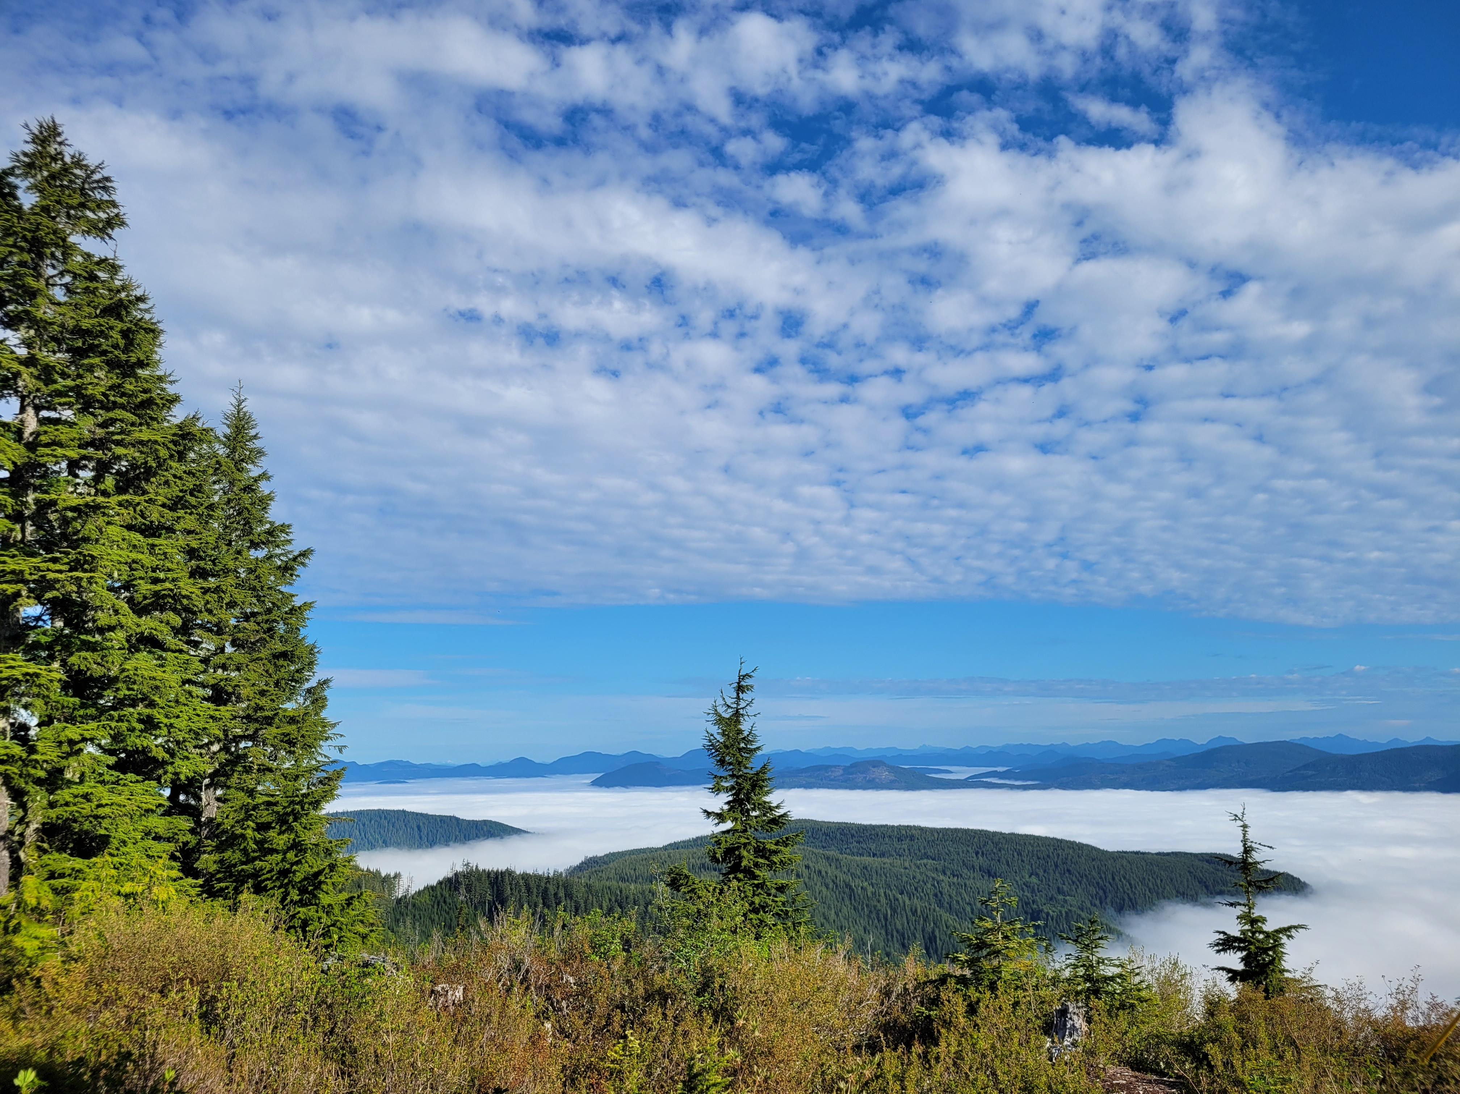

Tella Osler
Cameron Gillingham
Aaron Huinink
Notes:
Land ACK placeholder

Slide 2

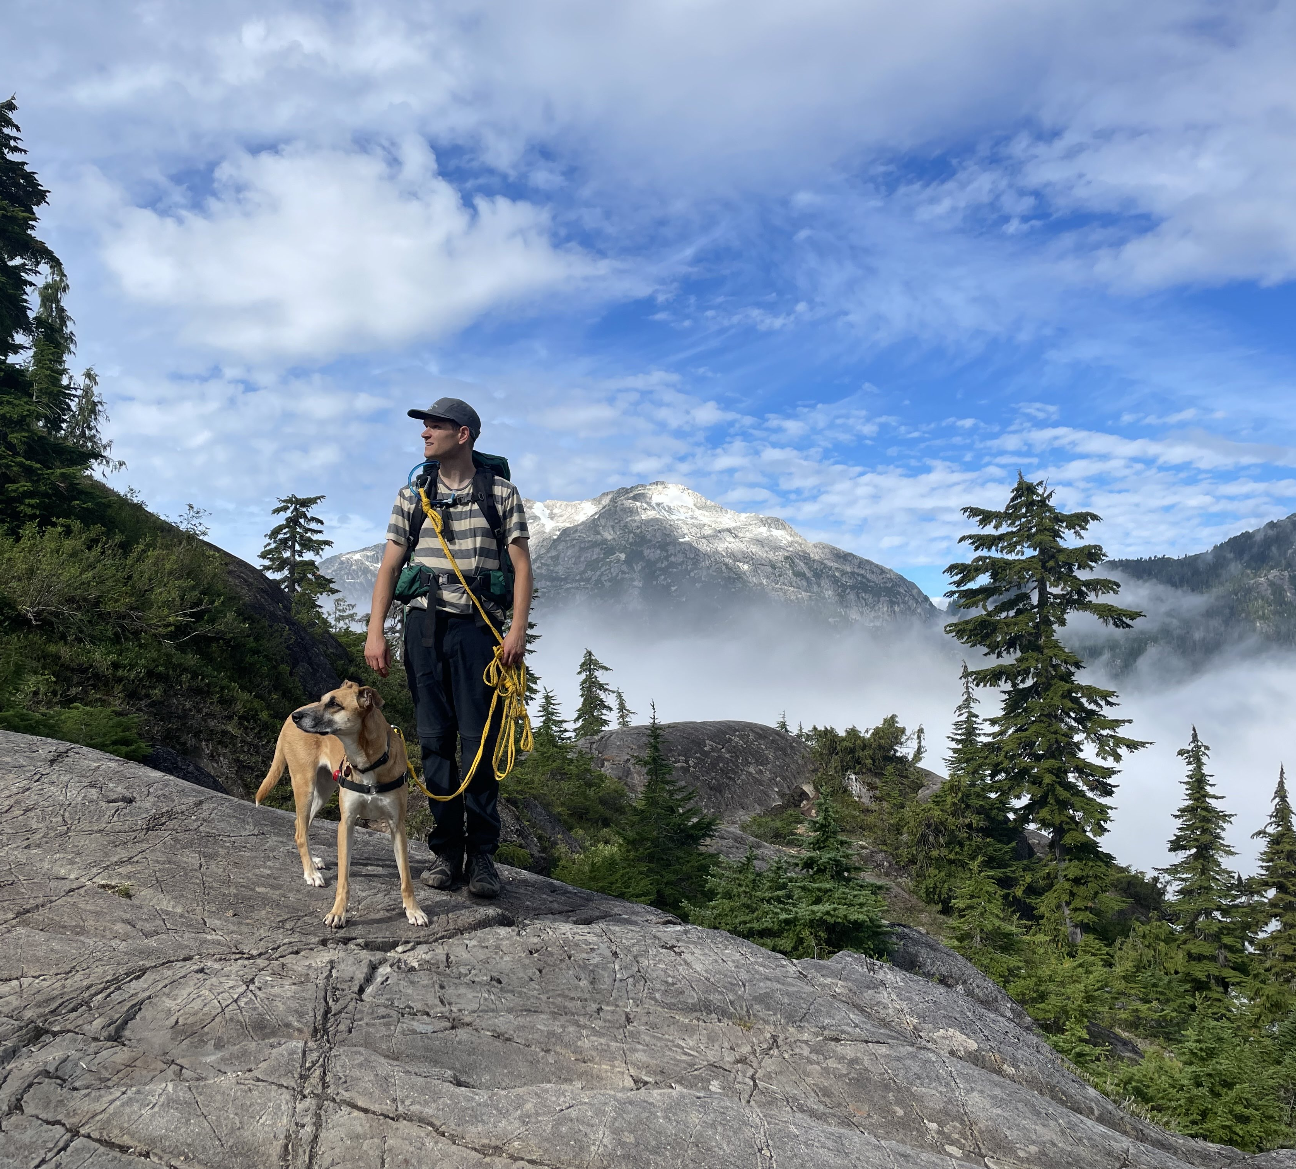
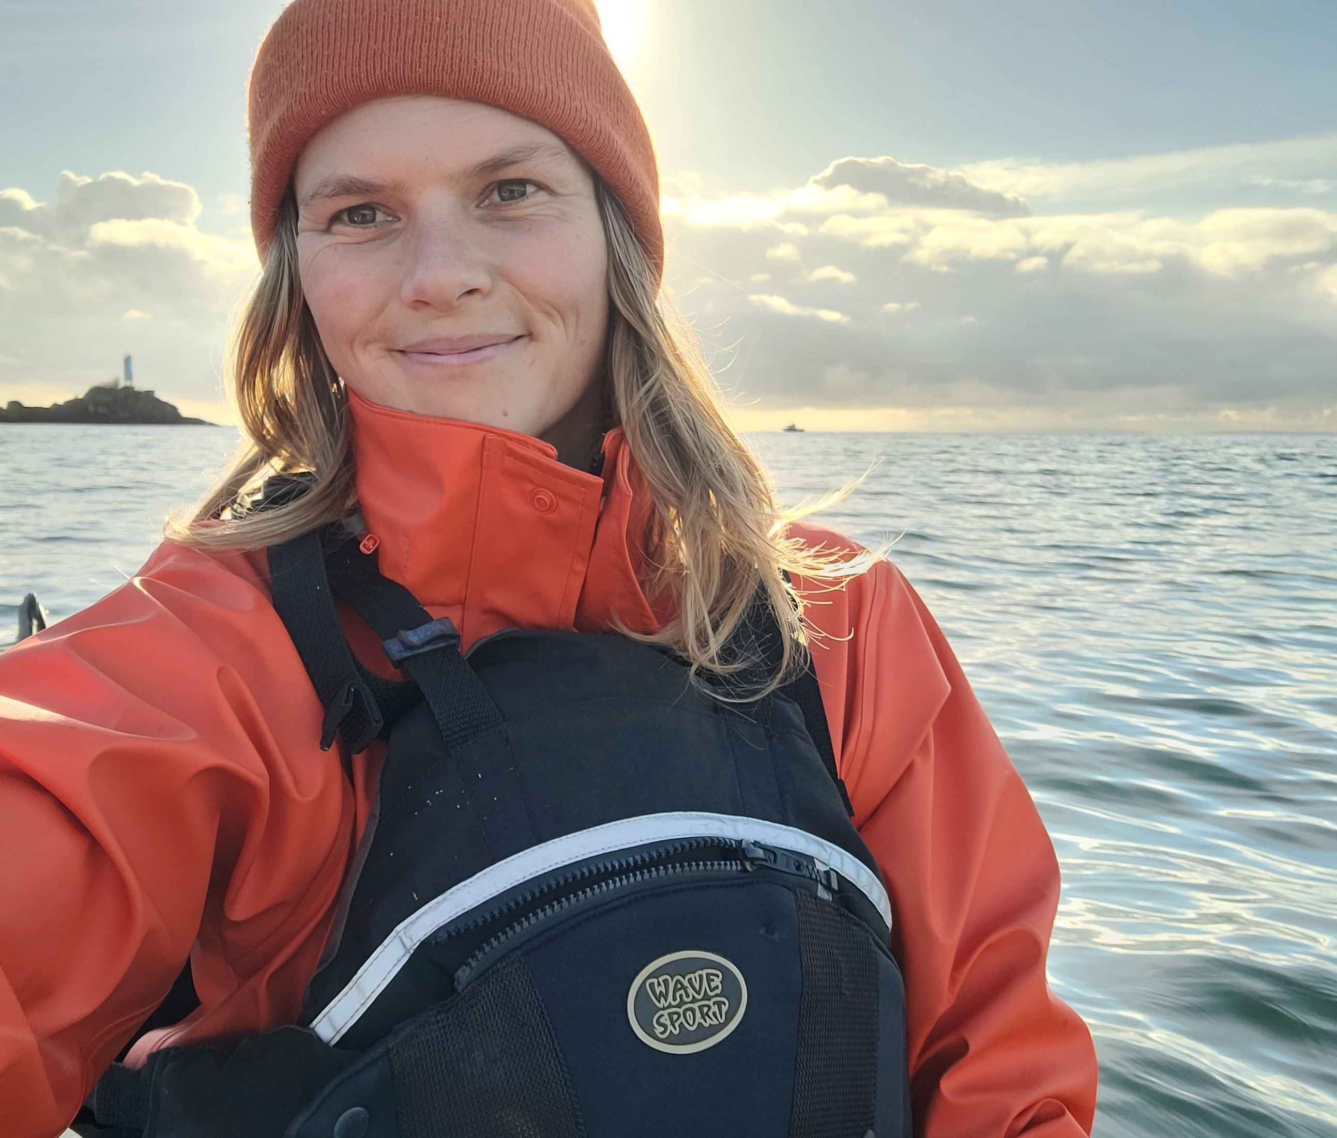
Flora Communications
Aaron Huinink
Cameron Gillingham
Tella Osler
Photo taken in Pacheedhat territory
Notes:
Land ACK

Slide 3


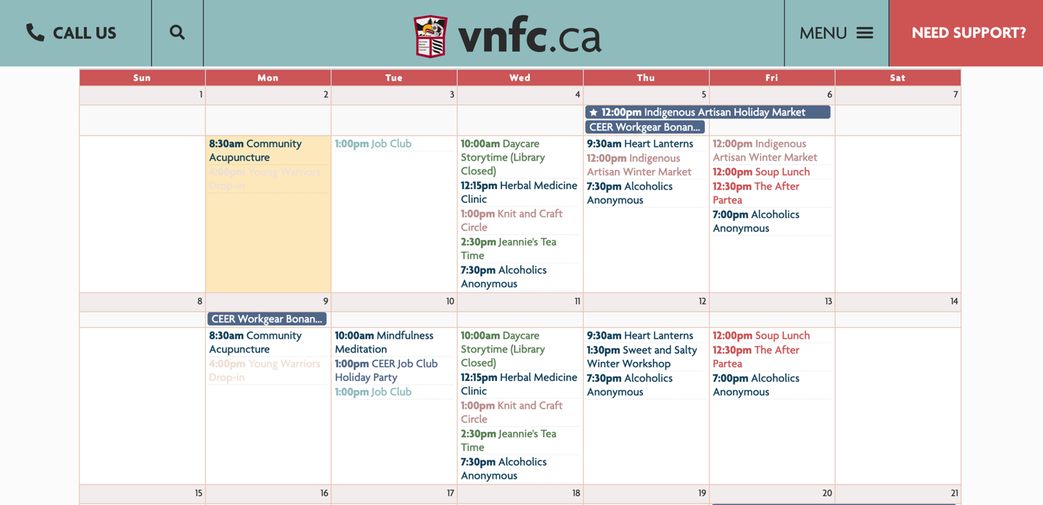
Victoria Native Friendship Centre
Notes:
Reconciliation and decolonialization are not overnight activities. This is a participatory and often challenging and uncomfortable journey. So, I’d like to highlight an incredible resource available here in town: the victoria native friendship centre. This is an indigenous led non-profit that deals with everything from finding housing to hosting art programs for indigenous and non–indigenous youth. So if you want to get involved, learn or donate, this is a great place to start.

Slide 4


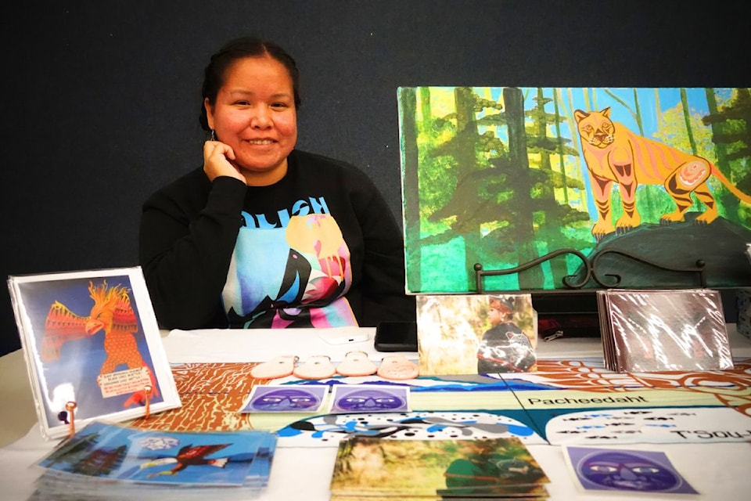
This Season
Indigenous Pop-up Market
Dec 21 (10-3pm)
Christmas Craft Market
Dec. 8 from 10:30 a.m. at Pauquachin Hall at 9010
W. Saanich Road
A fundraiser for an indigenous artistic exchange program abroad
Notes:
'Tis the season so, I thought we’d provide a few simple and tangible options to support some of our local first nations communities here in town. If you’re looking for Christmas gifts, or art there’s the Christmas craft market Dec 8, a fundraiser for an indigenous artist exchange program abroad. There’s also the indigenous pop-up market Dec 21 at the Norway house on Hillside. They’ll be accepting donations of toiletries and food for the unhoused.
Pauquachin (paw-kwi-chin)

Slide 5
Off-grid Communication
is Already in Your Pocket
Notes:
We're here today to introduce: FloraNet, an alternative means of backcountry communication.

Slide 6
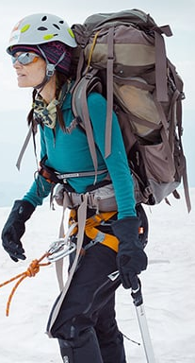
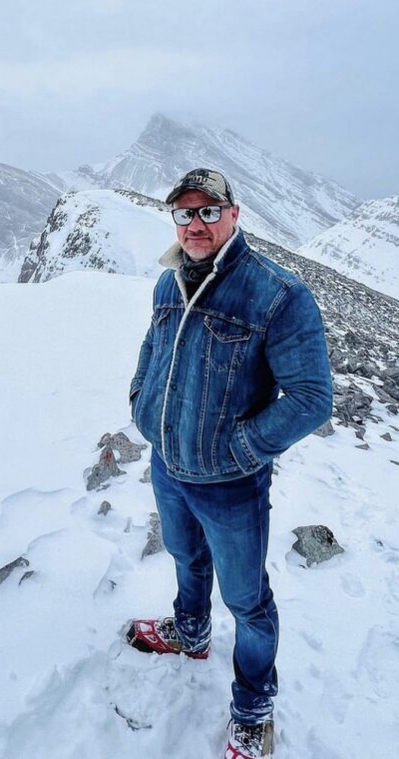
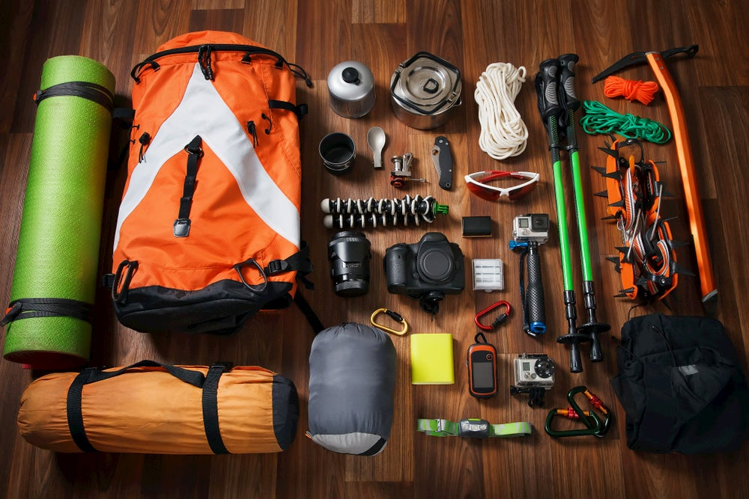

What do these hikers have in common?
Aunt Patagonia
Uncle Denim
Notes:
I’d like to start by introducing you all to aunt Patagonia and uncle denim, and presenting a question to the the group: what do these hiker have in common? The answer is that they can be found on the same trail with very different levels of preparedness
Is It OK To Hike In Jeans? (>800 Hikers Weigh In!) - Chasing Summits

Slide 7
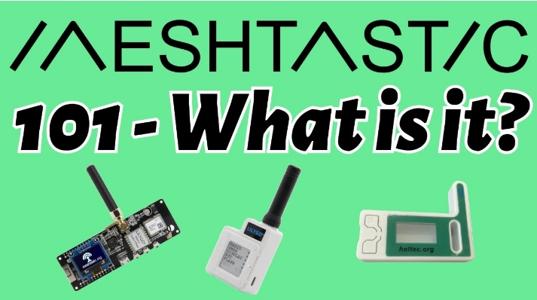
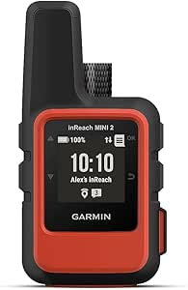
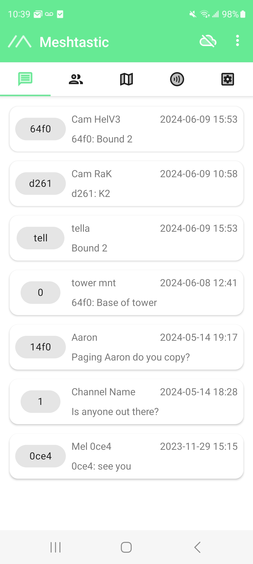
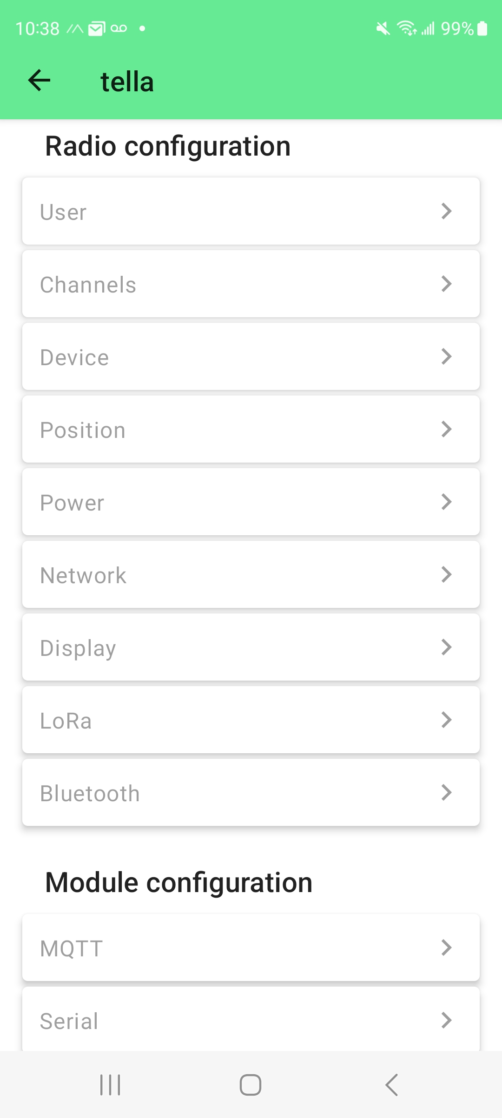
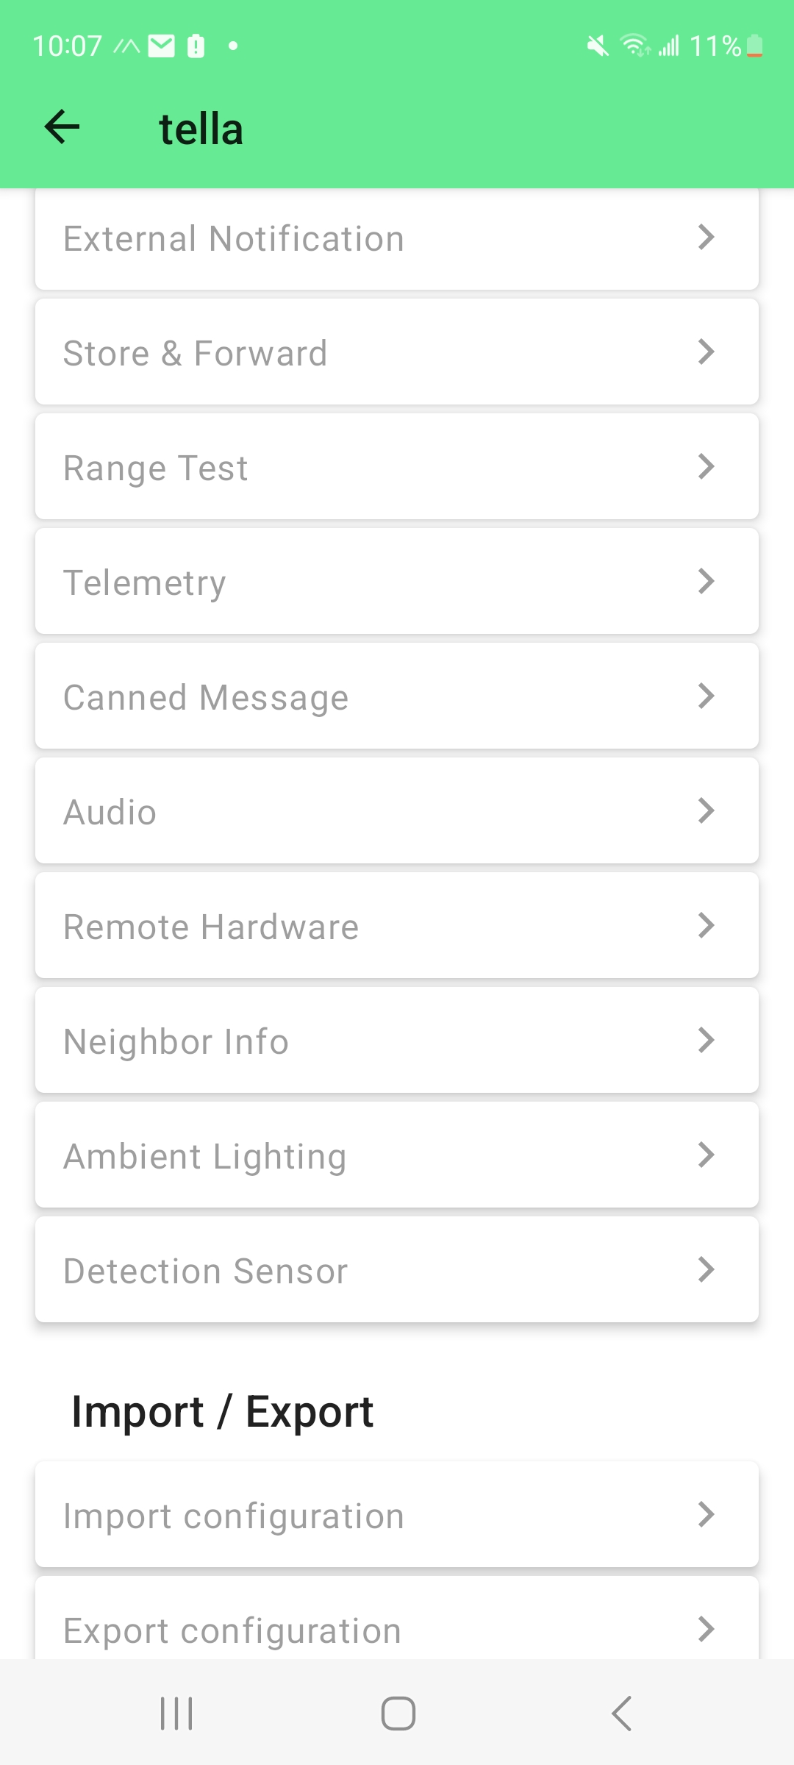
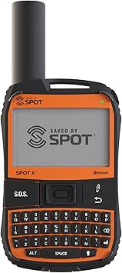
What’s out there?
Expensive satellite subscription device
2. Tech-savvy DIYer?
GARMIN
INREACH
Requires others to have a Meshtastic device in range of you!
SPOT X
Notes:
There are options out there for emergency communications, one is buying a satellite device like the Garmin inreach or spot X. These are great but come with a large upfront cost and you need to purchase a subscription plan on top of that.
Another option could be making your own DIY LoRa network using something like Meshtastic which we discussed earlier, this is a viable though still requires a person to purchase their own stand alone lora device and with all the configuration is really only accessible to someone that is quite tech-savvy

Slide 8
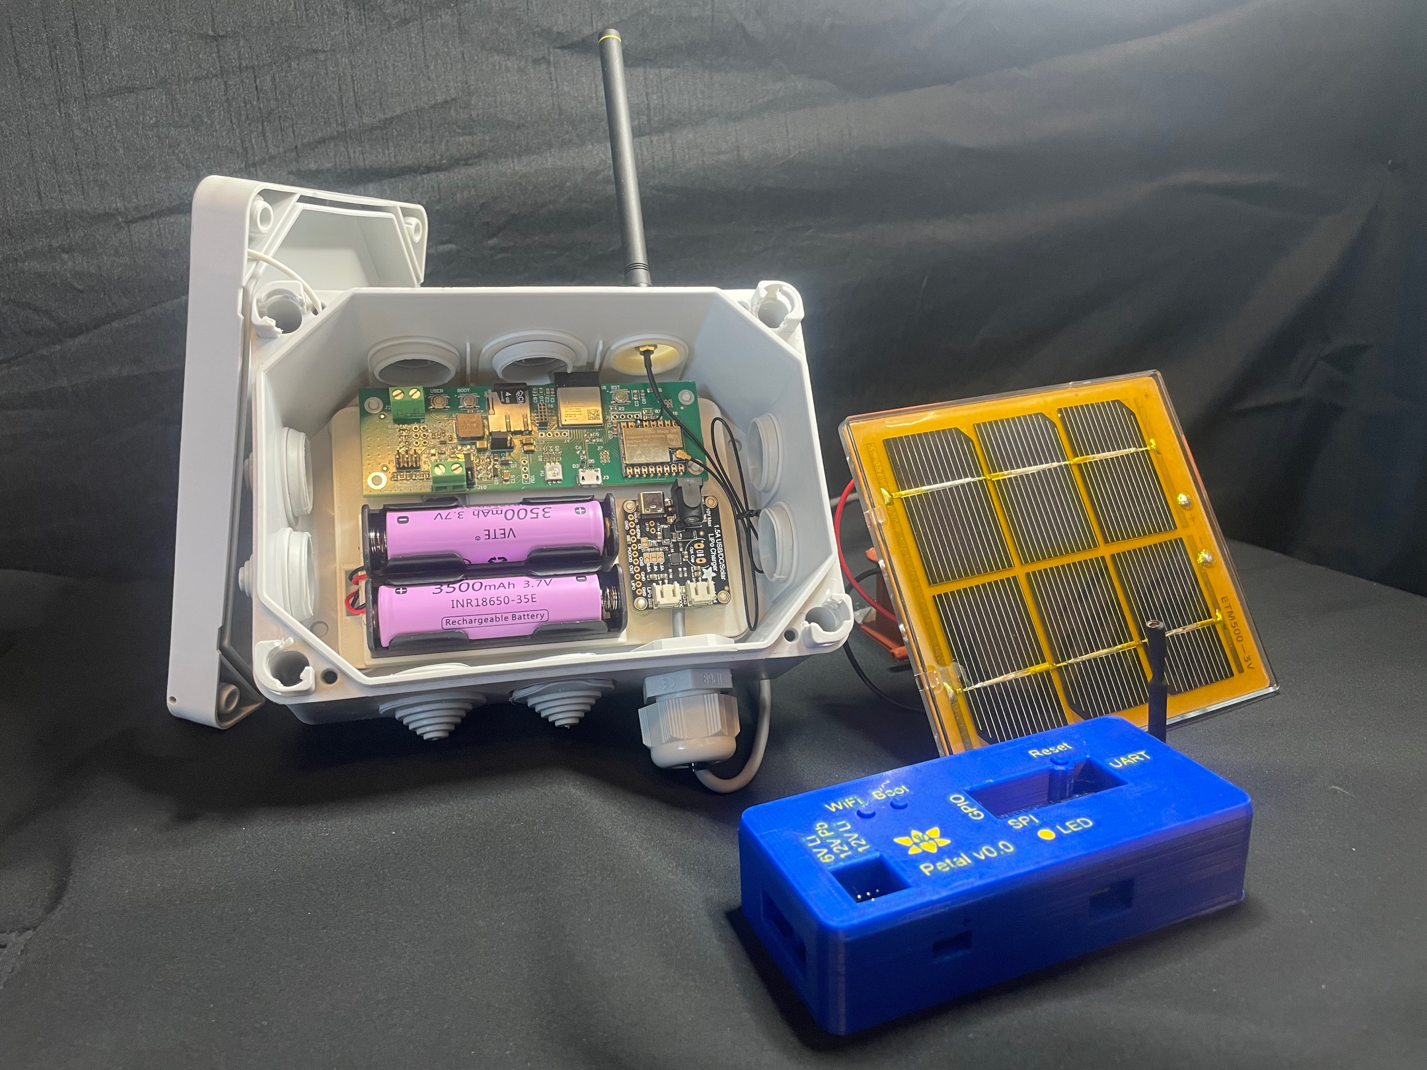
Our Solution: FloraNet
An installed LoRa Radio mesh network
Outdoor Solar-Powered Node
Indoor Petal Radio node
Notes:
We’ve came to the conclusion that for the average person looking to get outdoors the current options are likely too costly or overly complex for them to make use of.
We set about to make an approachable and accessible off-grid communication solution that any demographic regardless financial situation or technical know-how can use.

Slide 9
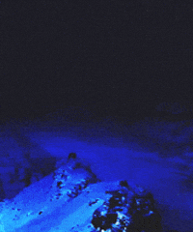
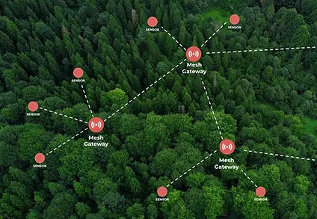
Mesh Network
LoTR mesh network
LoRa mesh network
Notes:
Aaron
LoRa Mesh Network
A web, where messages are passed along, repeated through the network.
So what is a mesh network?
LoRa radio stands for Long range and has very low power requirements, making it a perfect candidate for our application
we're using digital packets of data as messages instead of fire

Slide 10


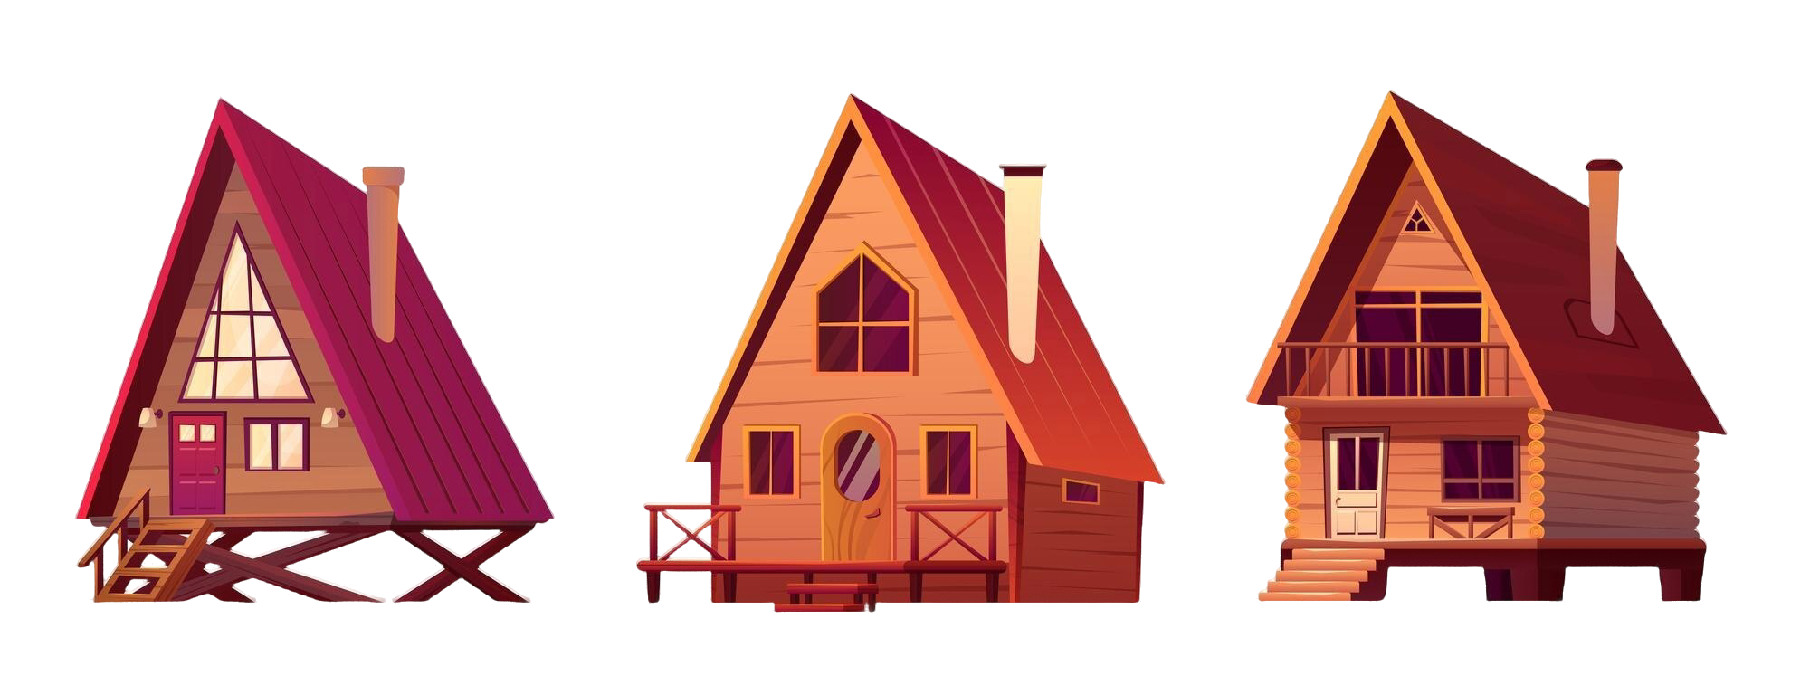

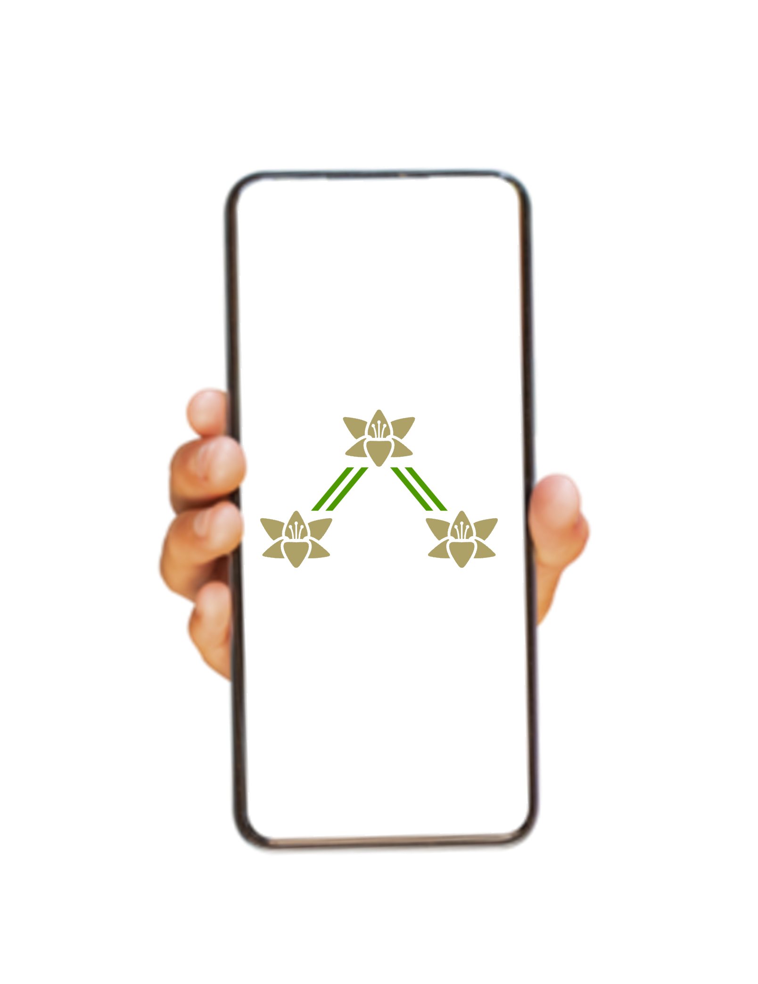
An Accessible, Standalone Network
LoRa signal
Wi-Fi signal
Radio Node
No special hardware, external app, or user account required
Trail
Notes:
This is FloraNet, a user-friendly, installed network that people can access with their smart-phones. The user doesn’t need additional hardware or to download an application, just connect to a node and begin messaging via their phone’s web-browser.
This network is geared towards installation on established trails, or recreation sites such as ski hills. This network caters to all, but especially recreators who aren’t going to spend money on expensive satellite subscription devices (uncle Denim) when they’re out in the back country for a few days a year. These are casual recreators that will not have a communication device on them, and that cost can be taken on by the trail/outdoors clubs, or ski resorts. This cost being transferred to the a group or business would allow for people who’d otherwise have no means of communication in an emergency, the ability to call for help. This could all happen for the price of 1 garmin inreach which serves only 1 group. This would be a network serving all recreators on the trail, they only require the smartphone in their pocket.
So how would someone use this network?
The key is in the simplicity. The user can connect to a wifi access point as you do many times throughout the day.
Scan a QR code, and arrive at the web app on their phone’s browser and start using the public chat.
The user types their message into the chat and presses send. The message is then bundled as a packet of data and transmitted through the network by LoRa radio (think texting walkie-talkie).

Slide 11
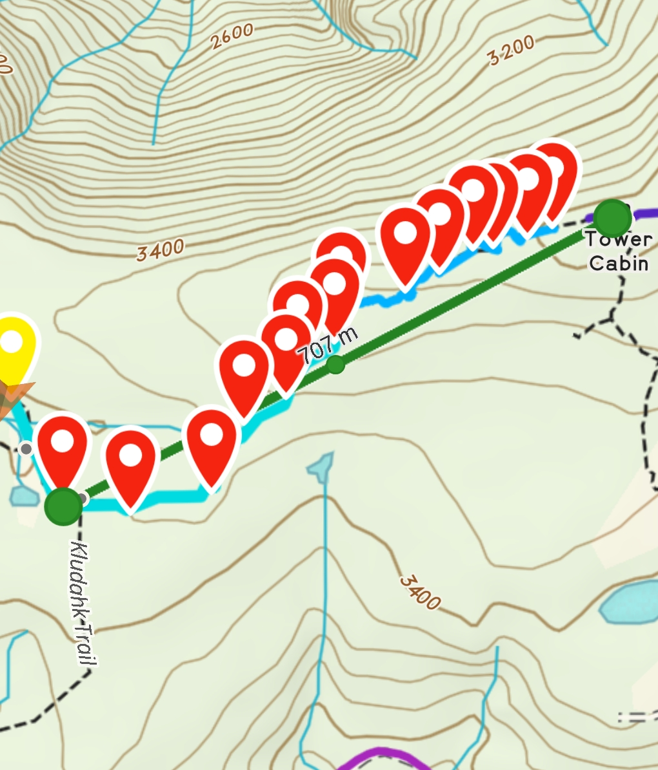
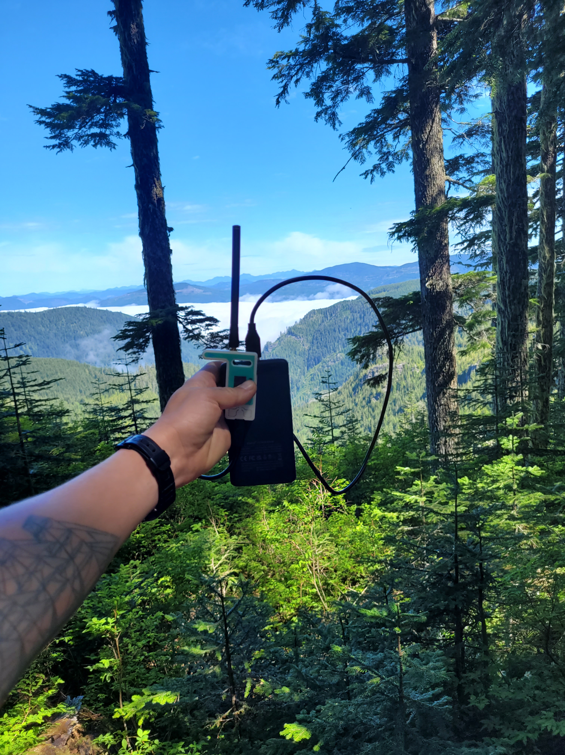
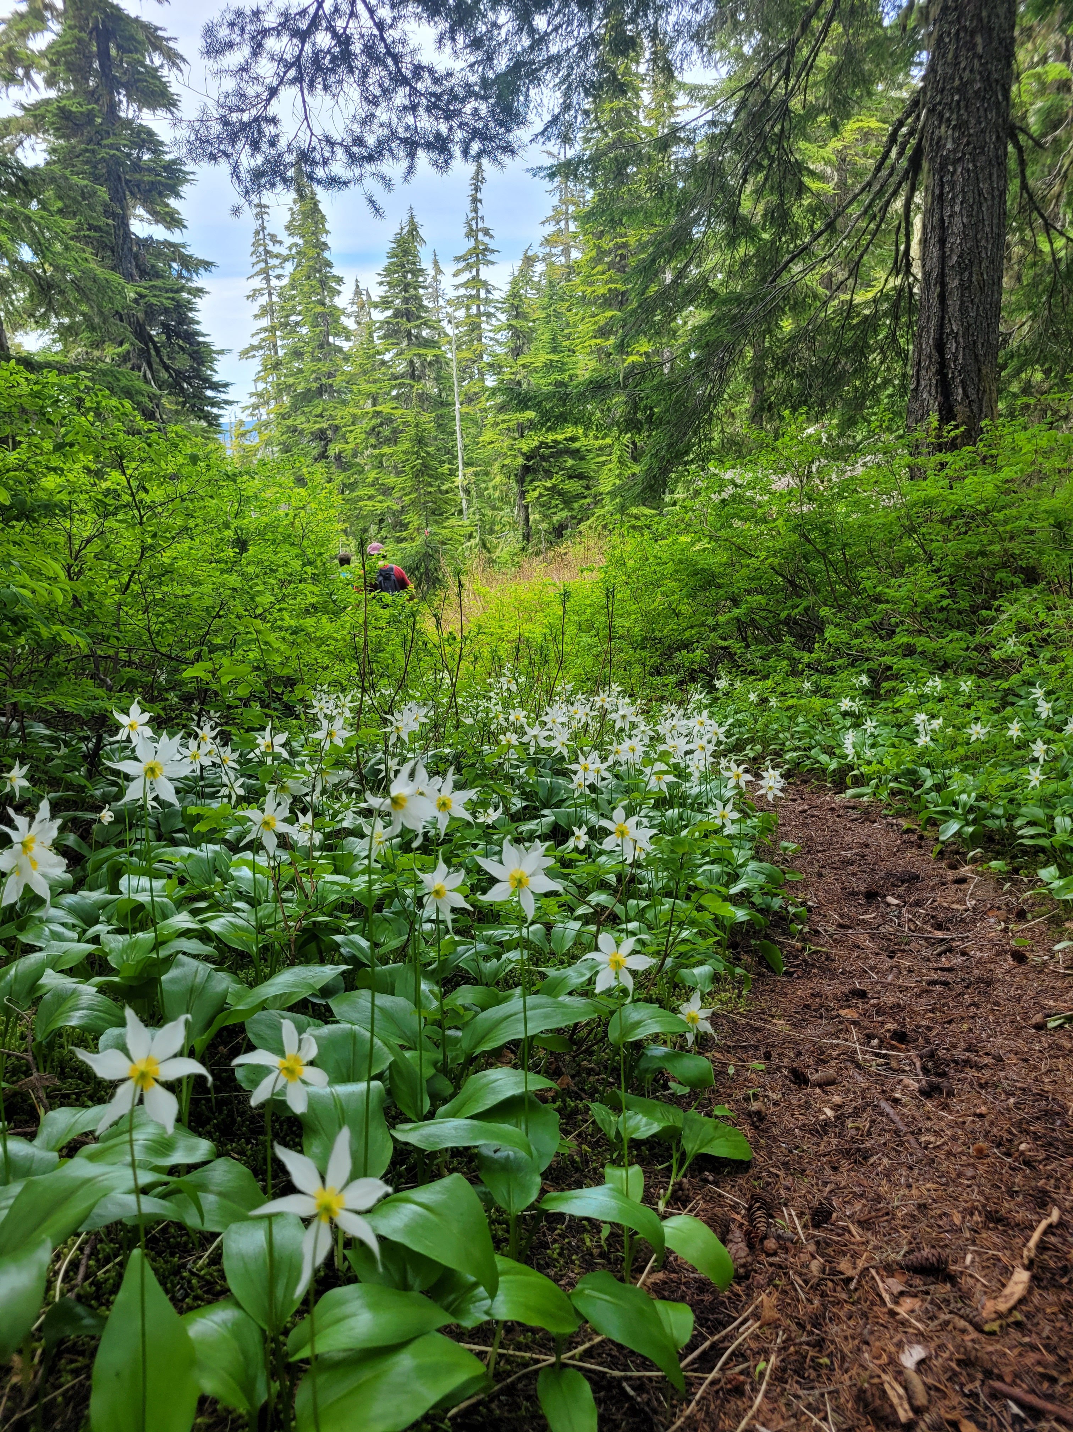
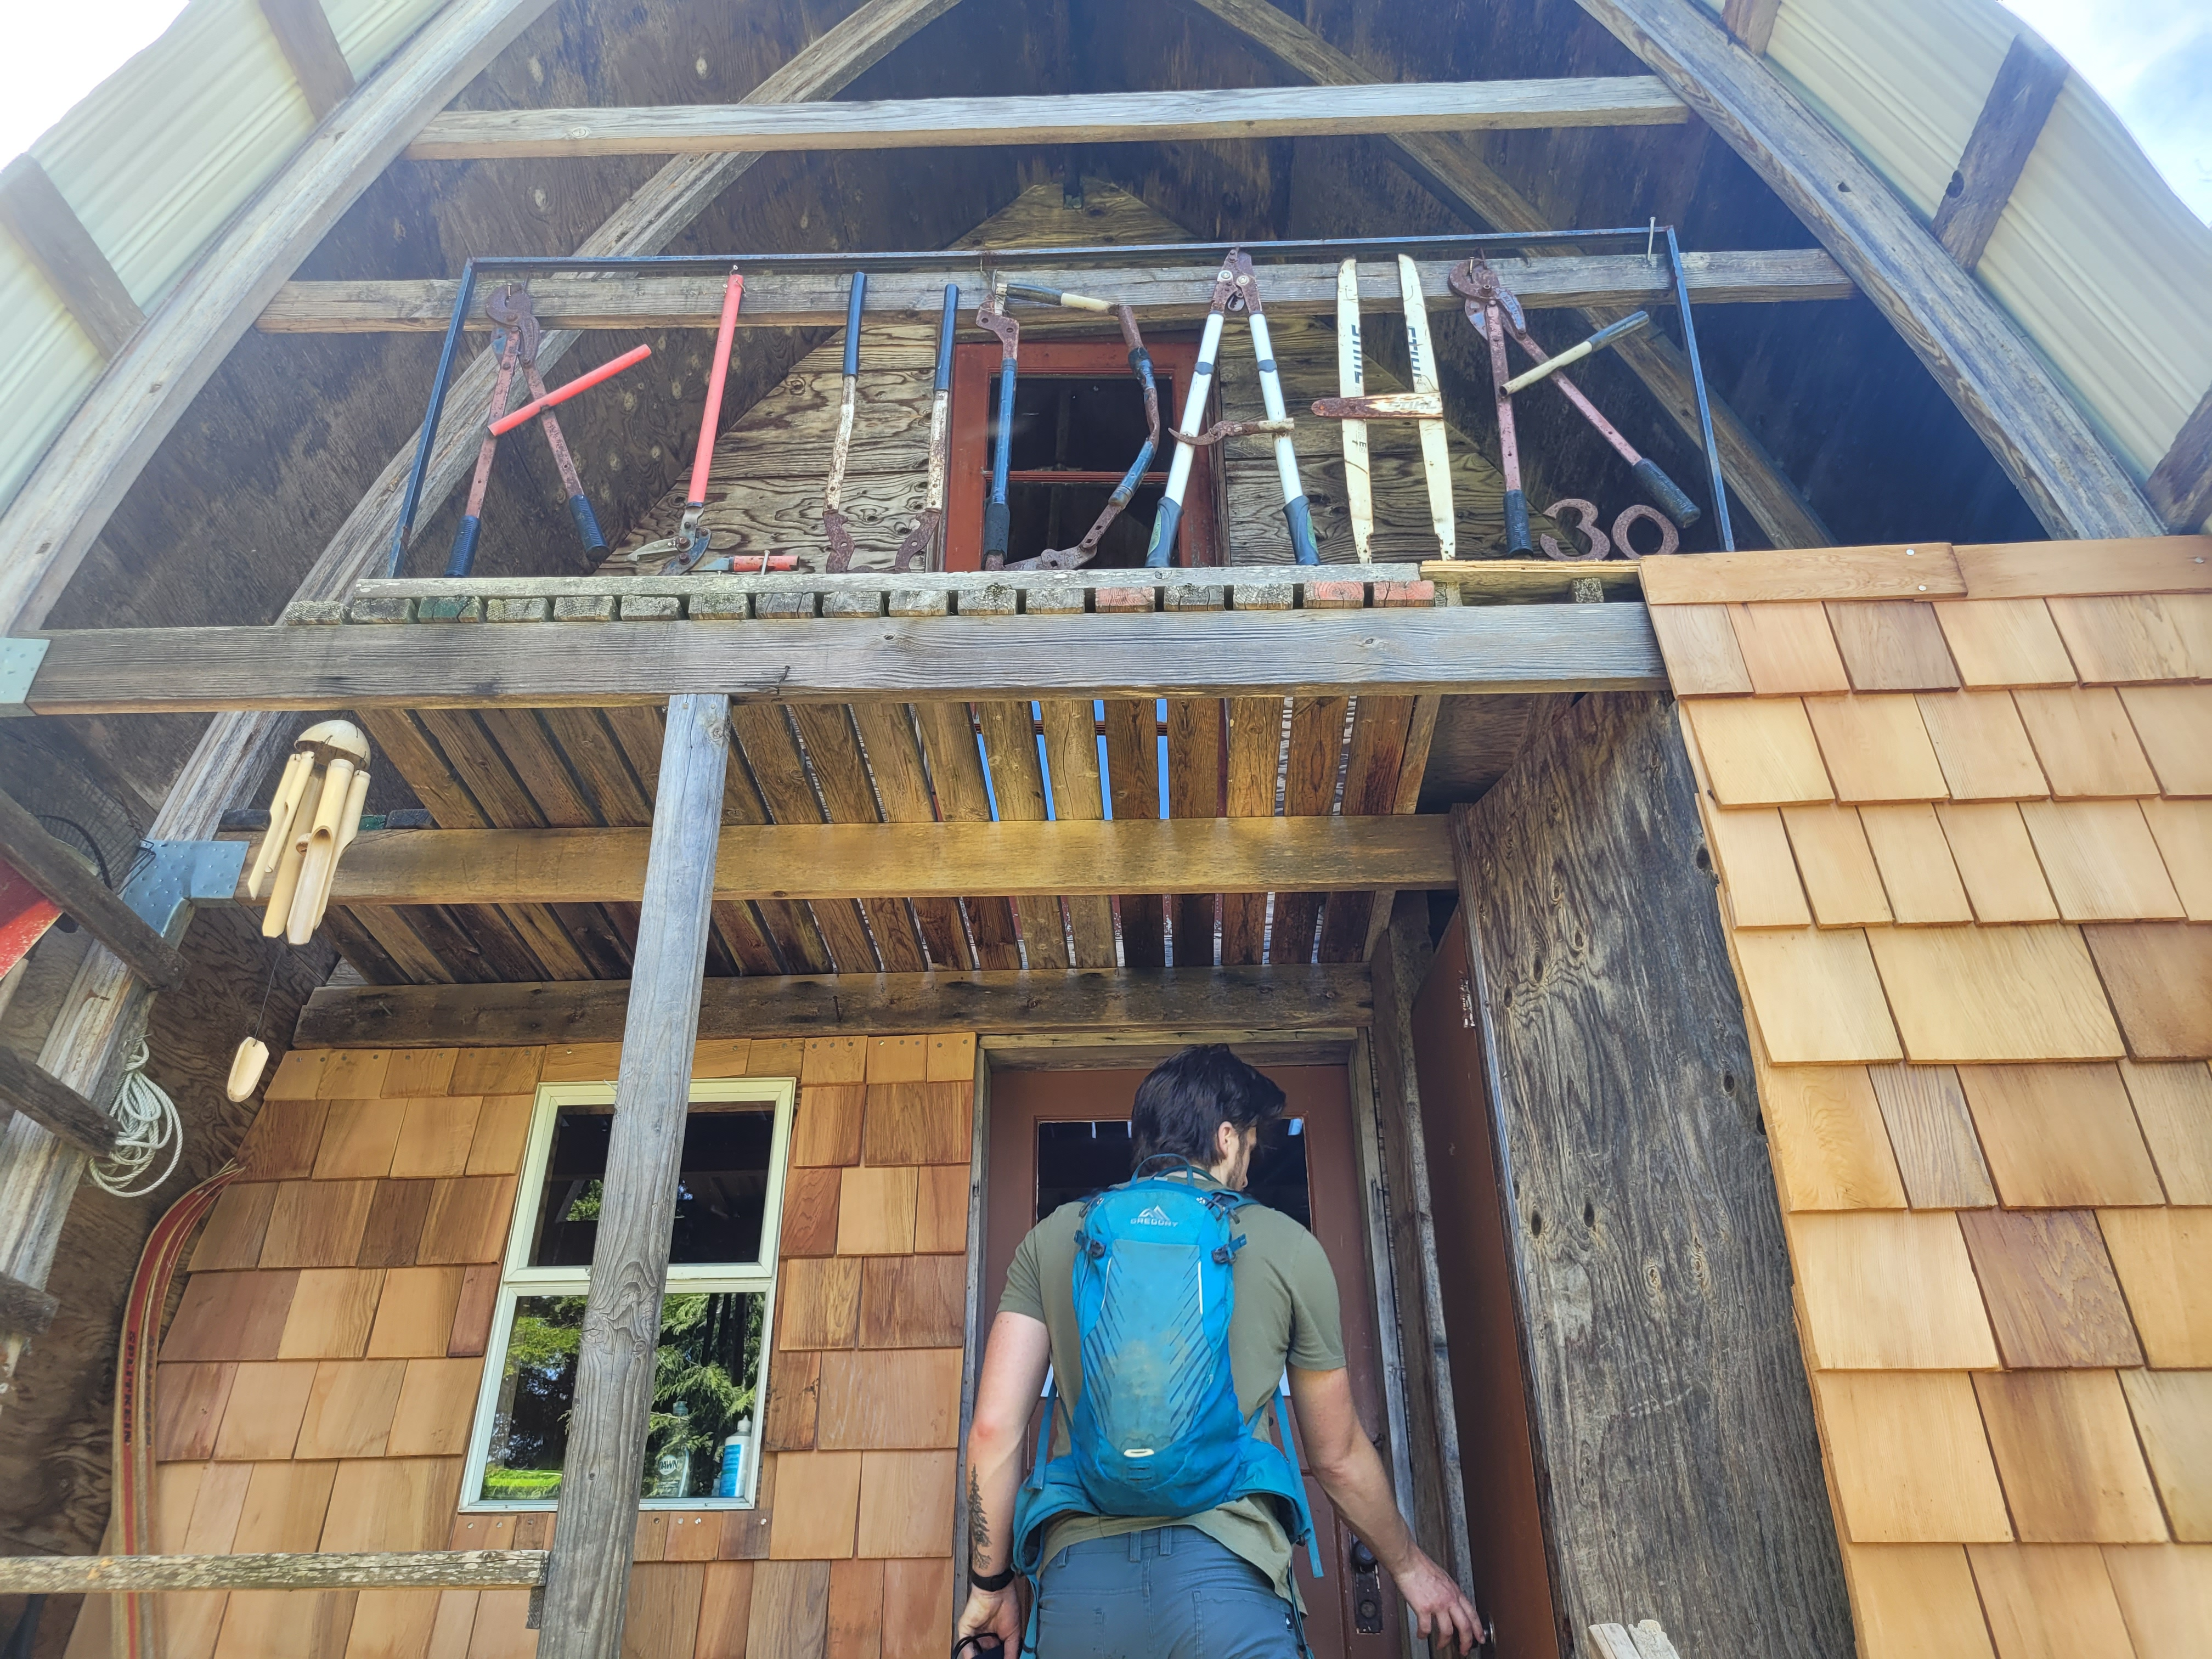
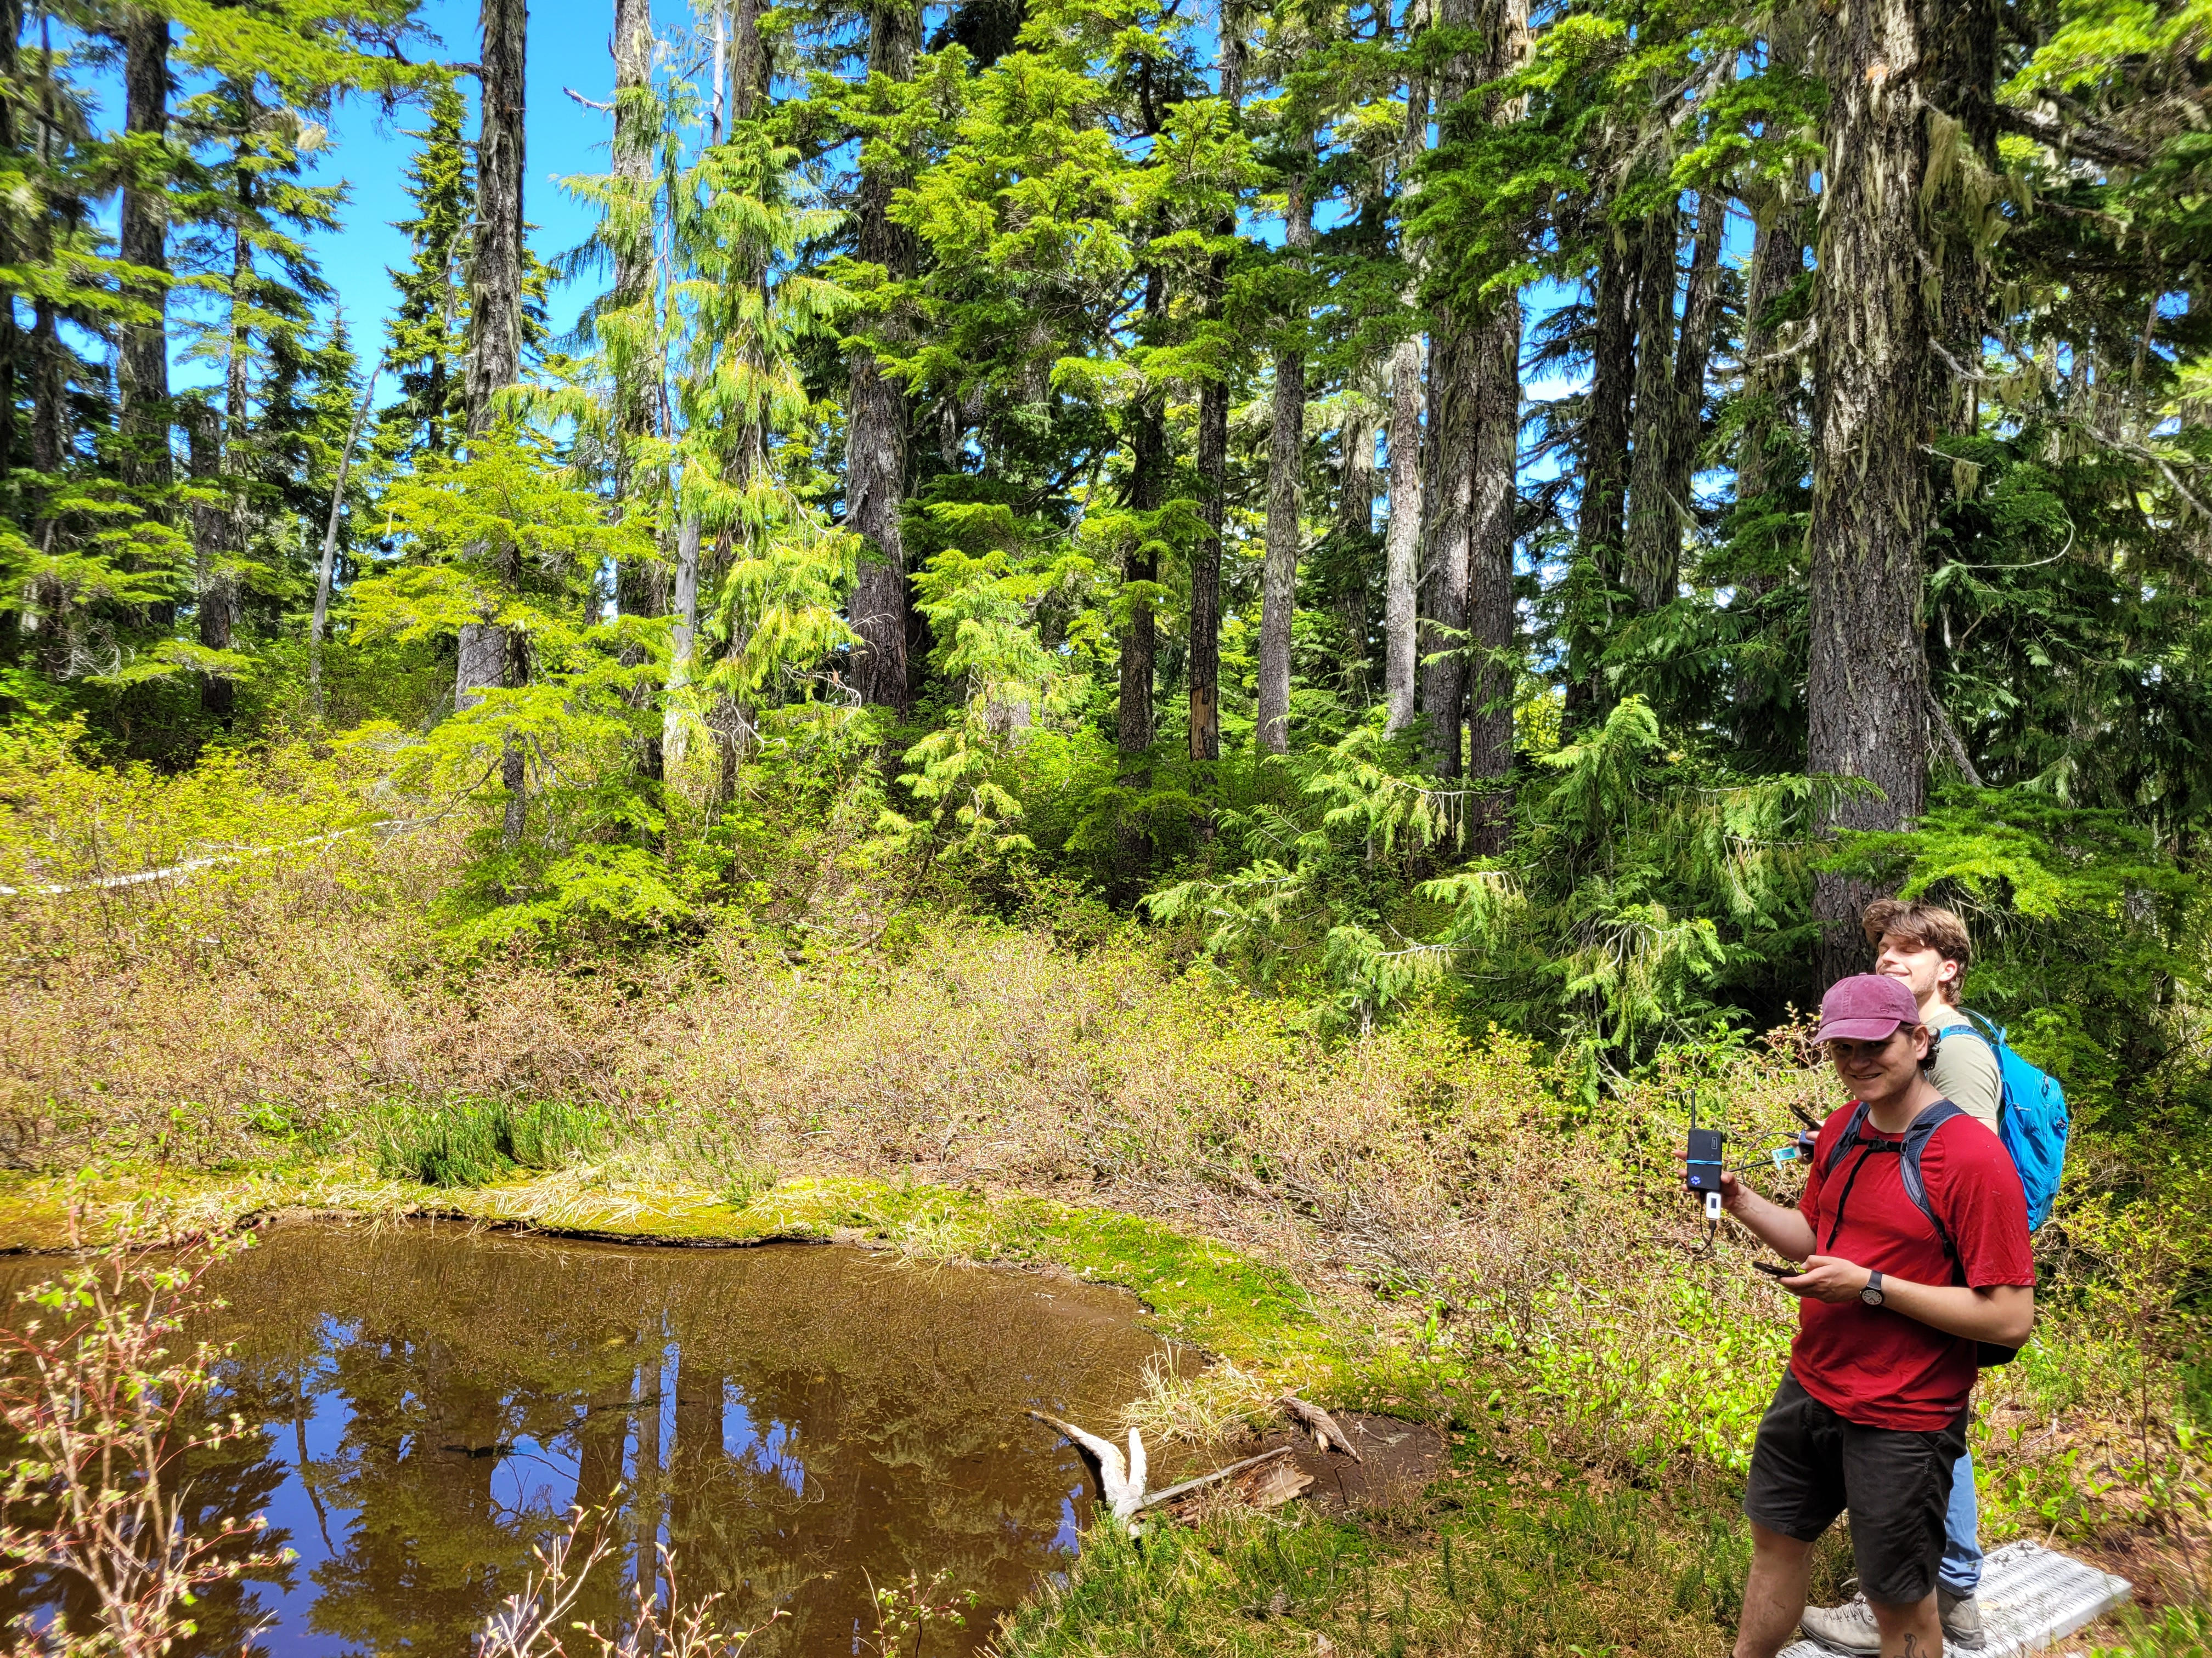
Proving Feasibility
Notes:
Before diving into things too deep we wanted to prove the feasibility of our project. We set out to the Kludahk with some cheap handheld LoRa modules and to our surprise were able to transmit and receive messages upwards of a kilometer through the dense forest.
The trail was scattered with gorgeous avalanche lillies at that time of year which inspired the name of our project: FloRa Communications

Slide 12
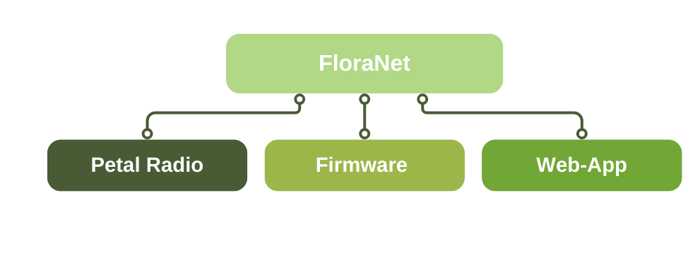
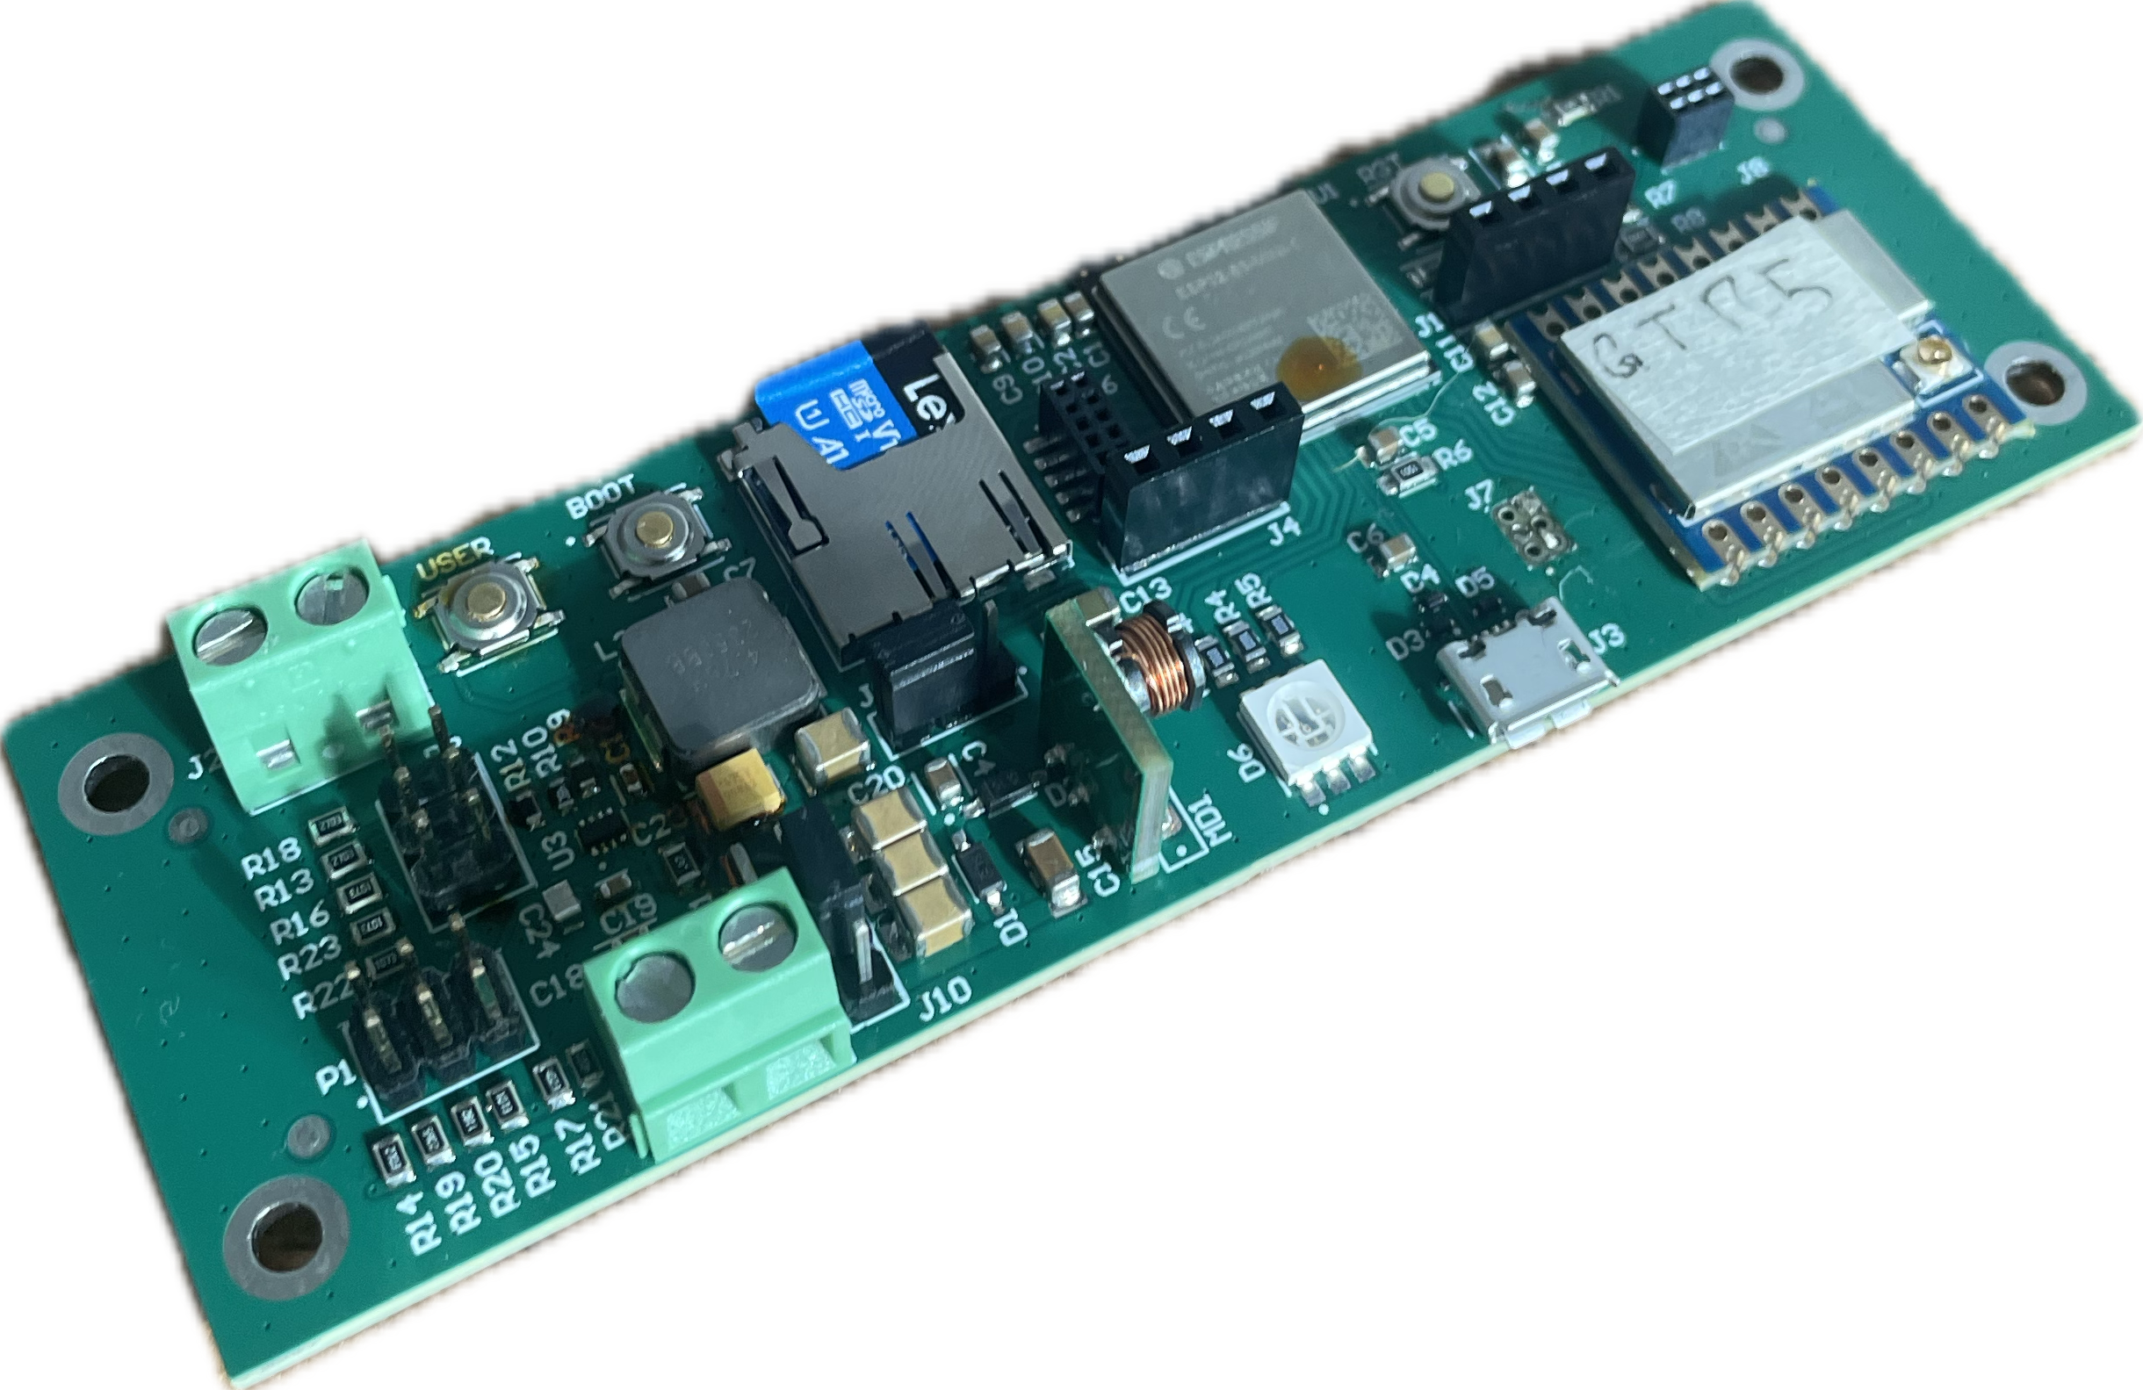
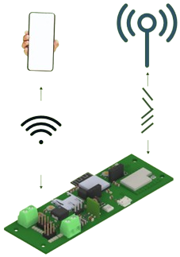
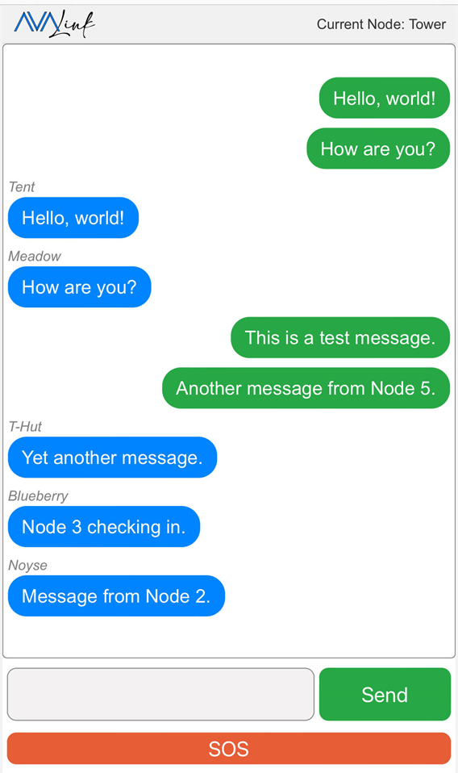
FloraNet Comes to Life
FloraNet has three crucial parts
Notes:
FloraNet is comprised of Petal Radios, these serve as the nodes that transmit and receive messages throughout the network. We’ve written custom firmware for the petals that handles tasks such as power management, the messaging protocol, and serving the web application. Finally, this all needs a user-interface, and we’ve designed an intuitive web-application to handle this.

Slide 13
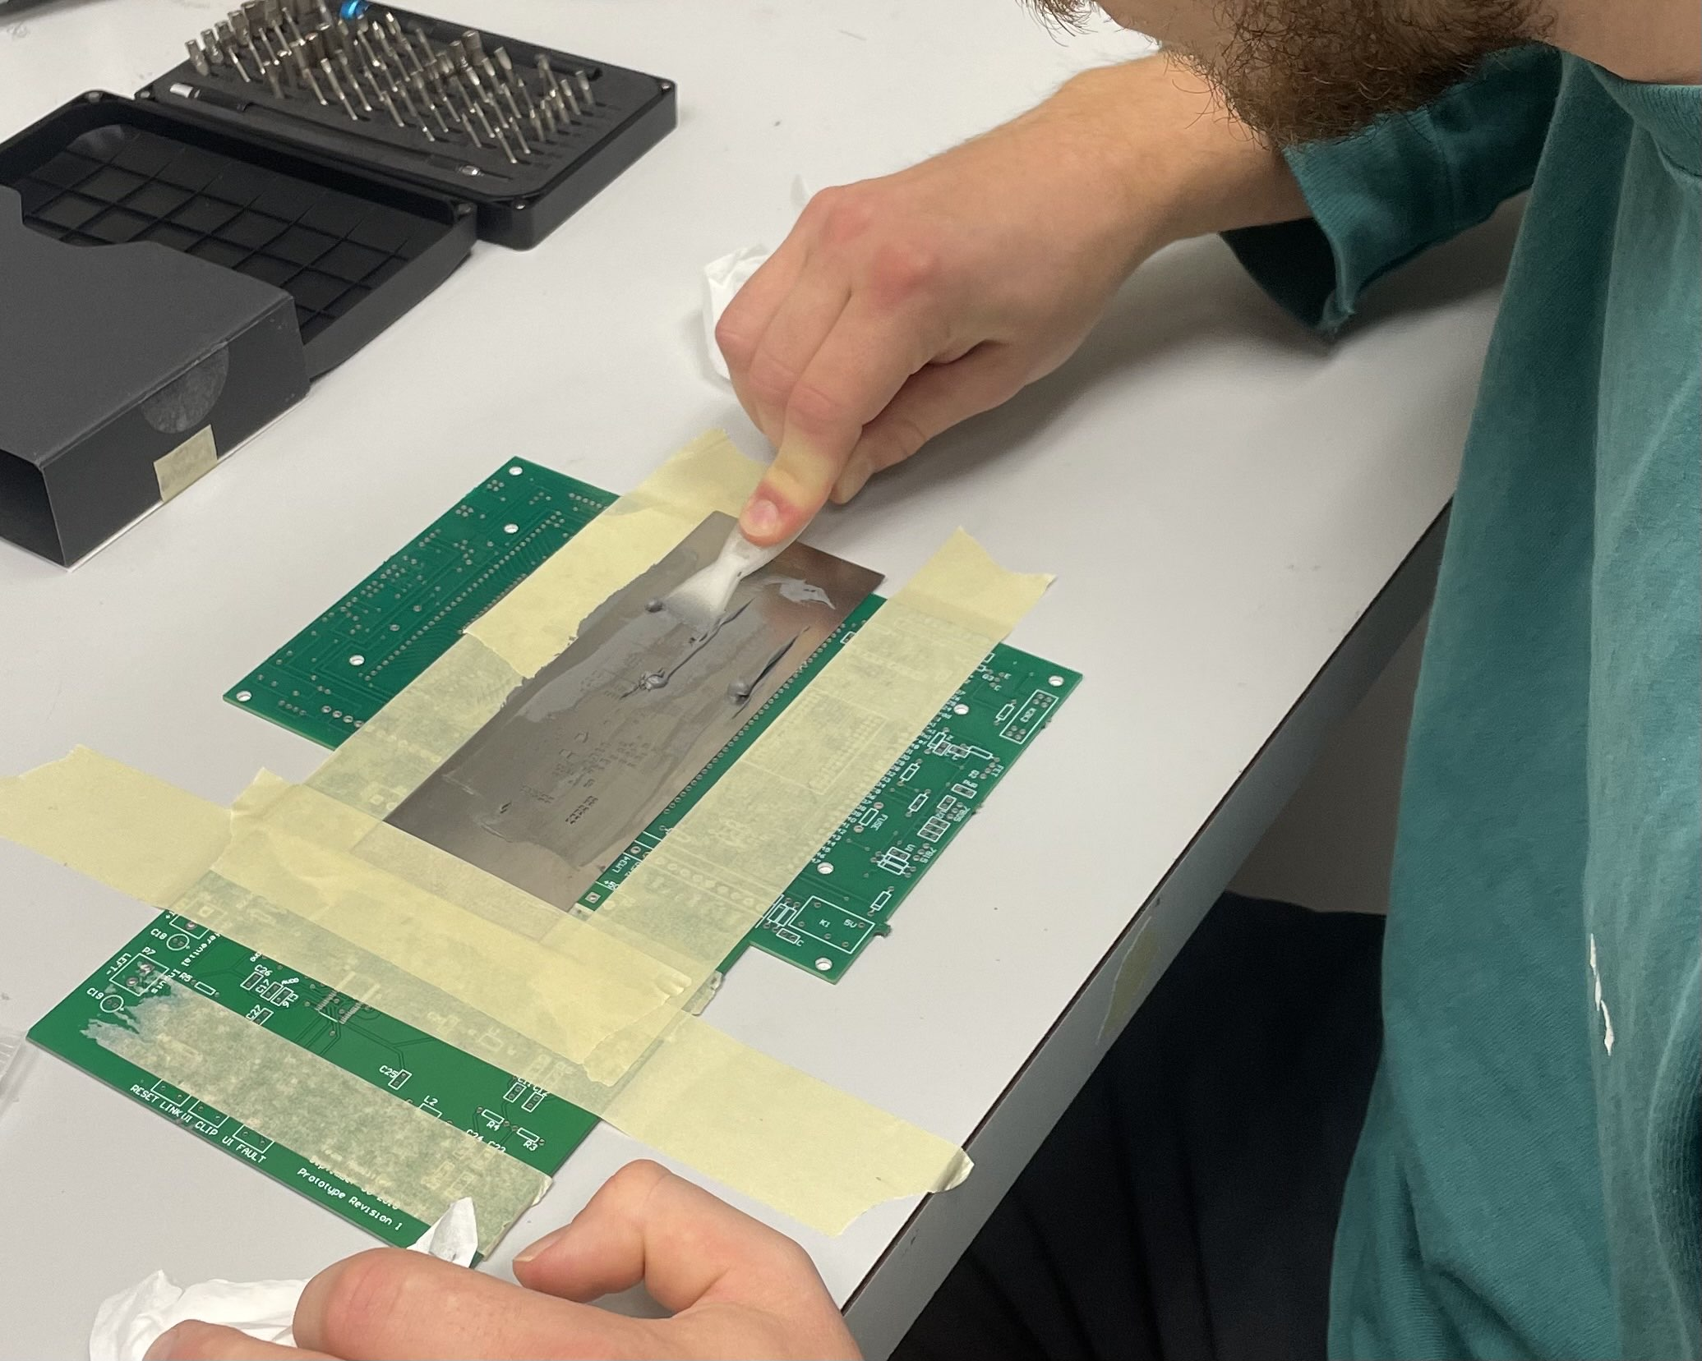
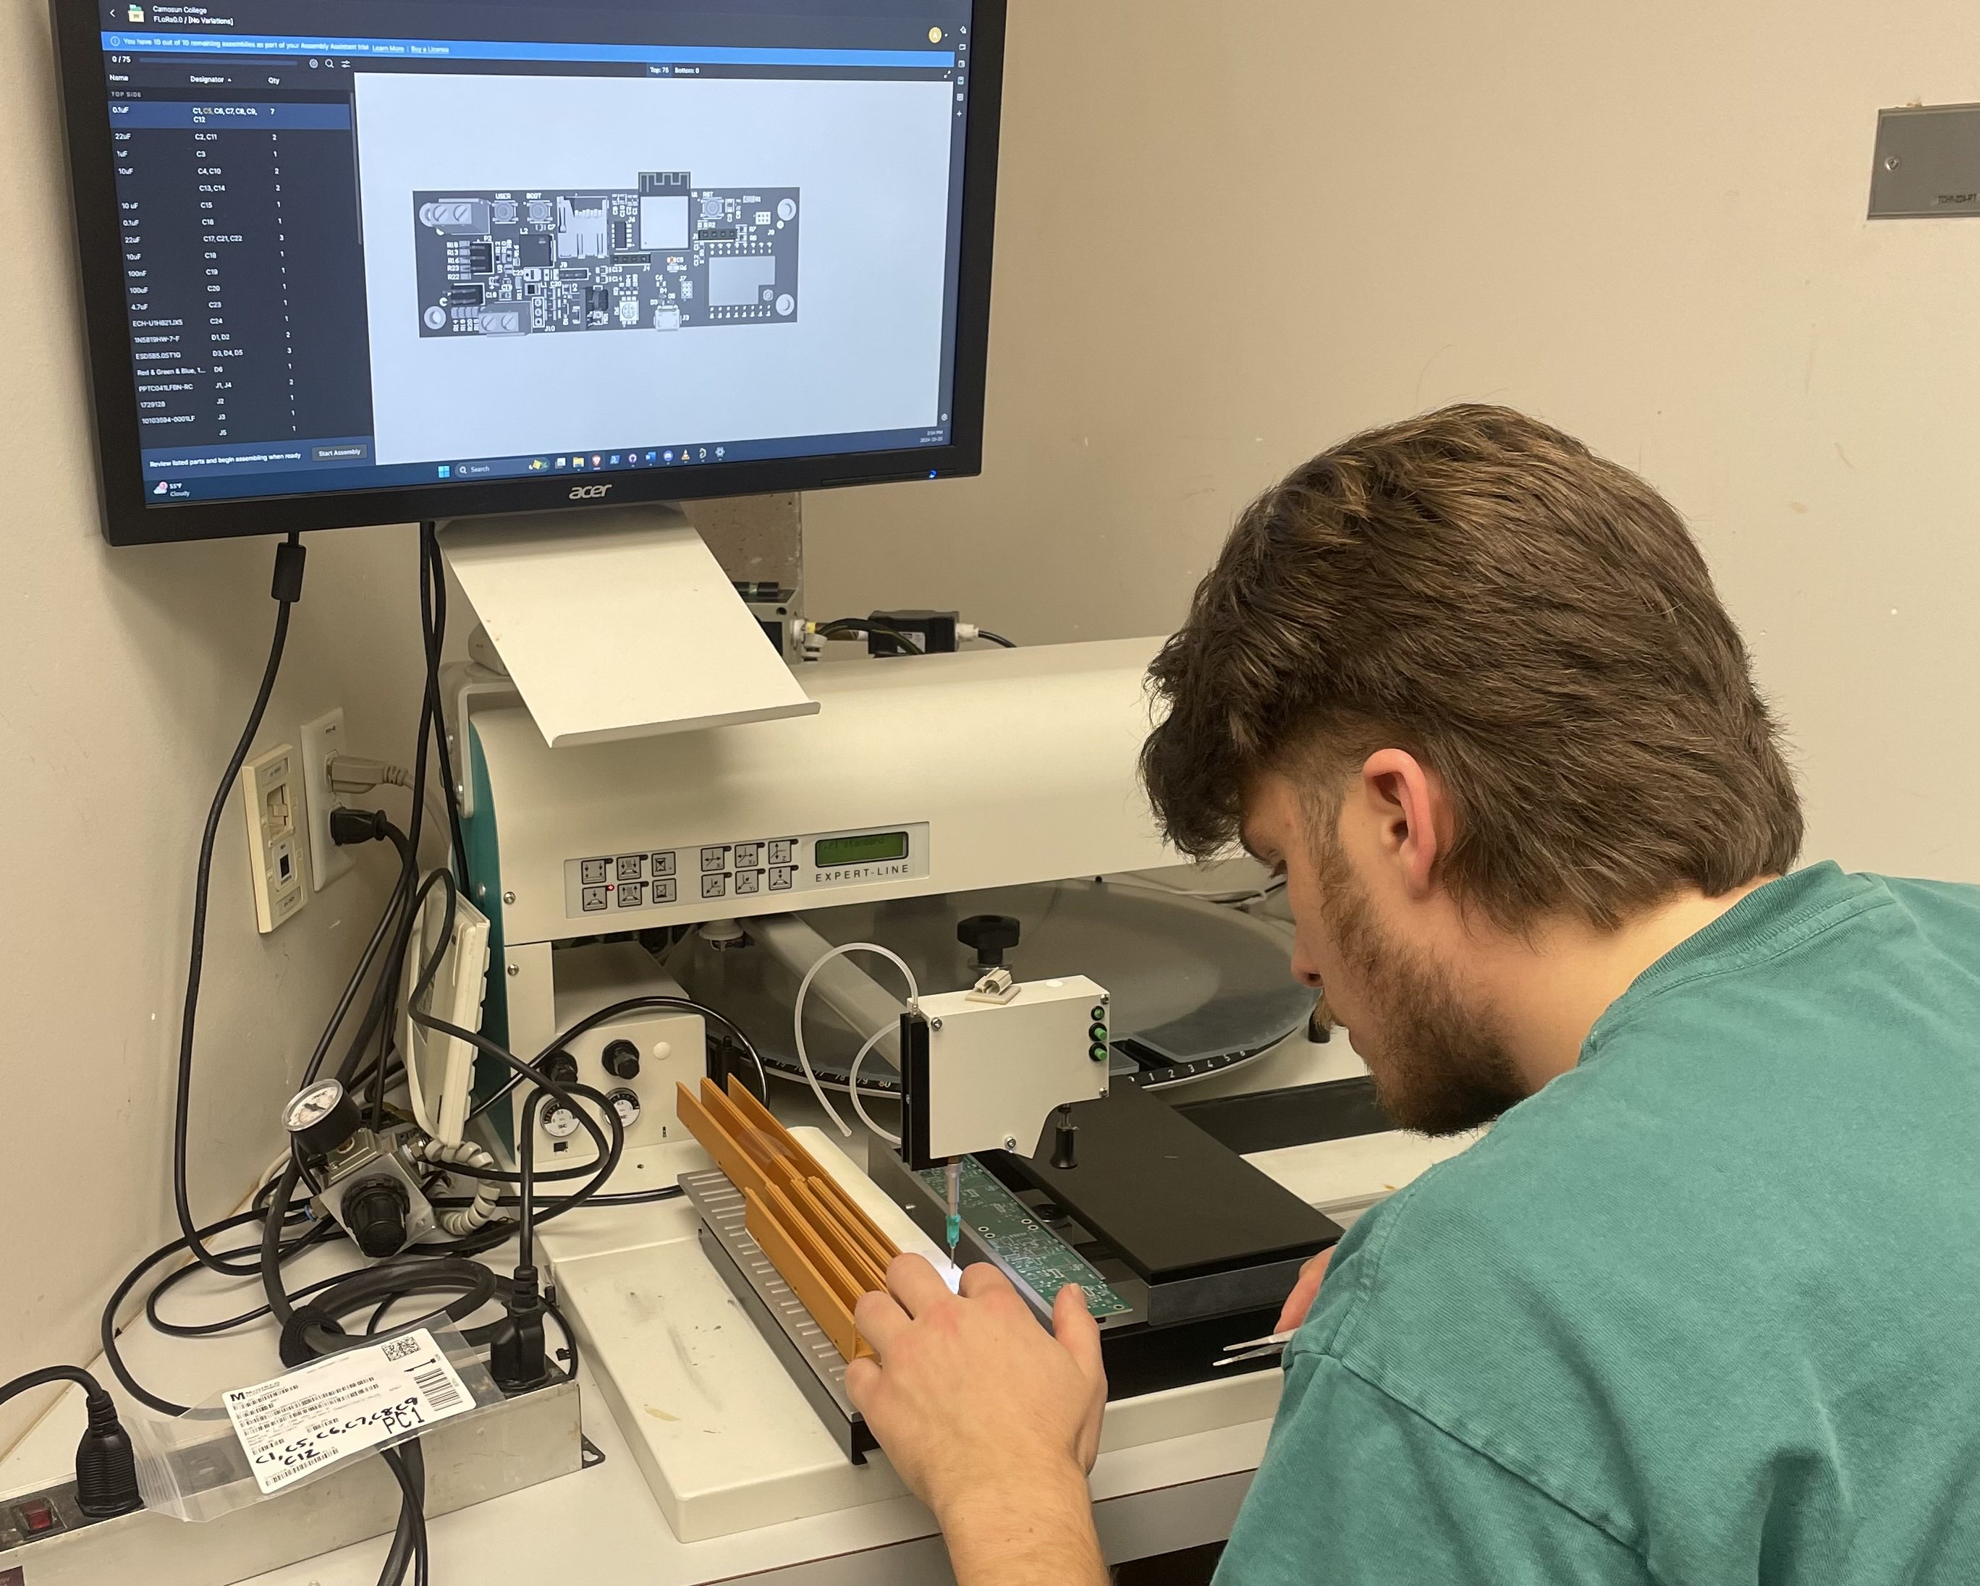
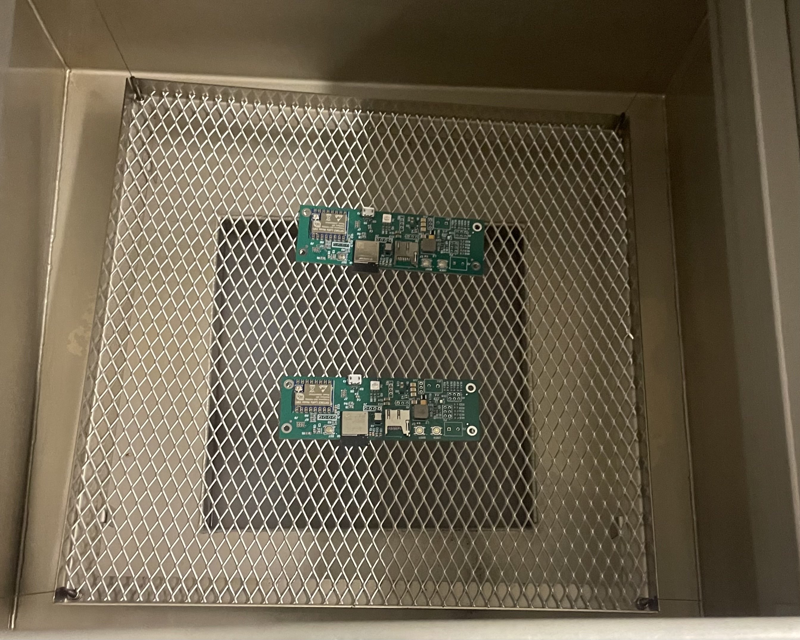
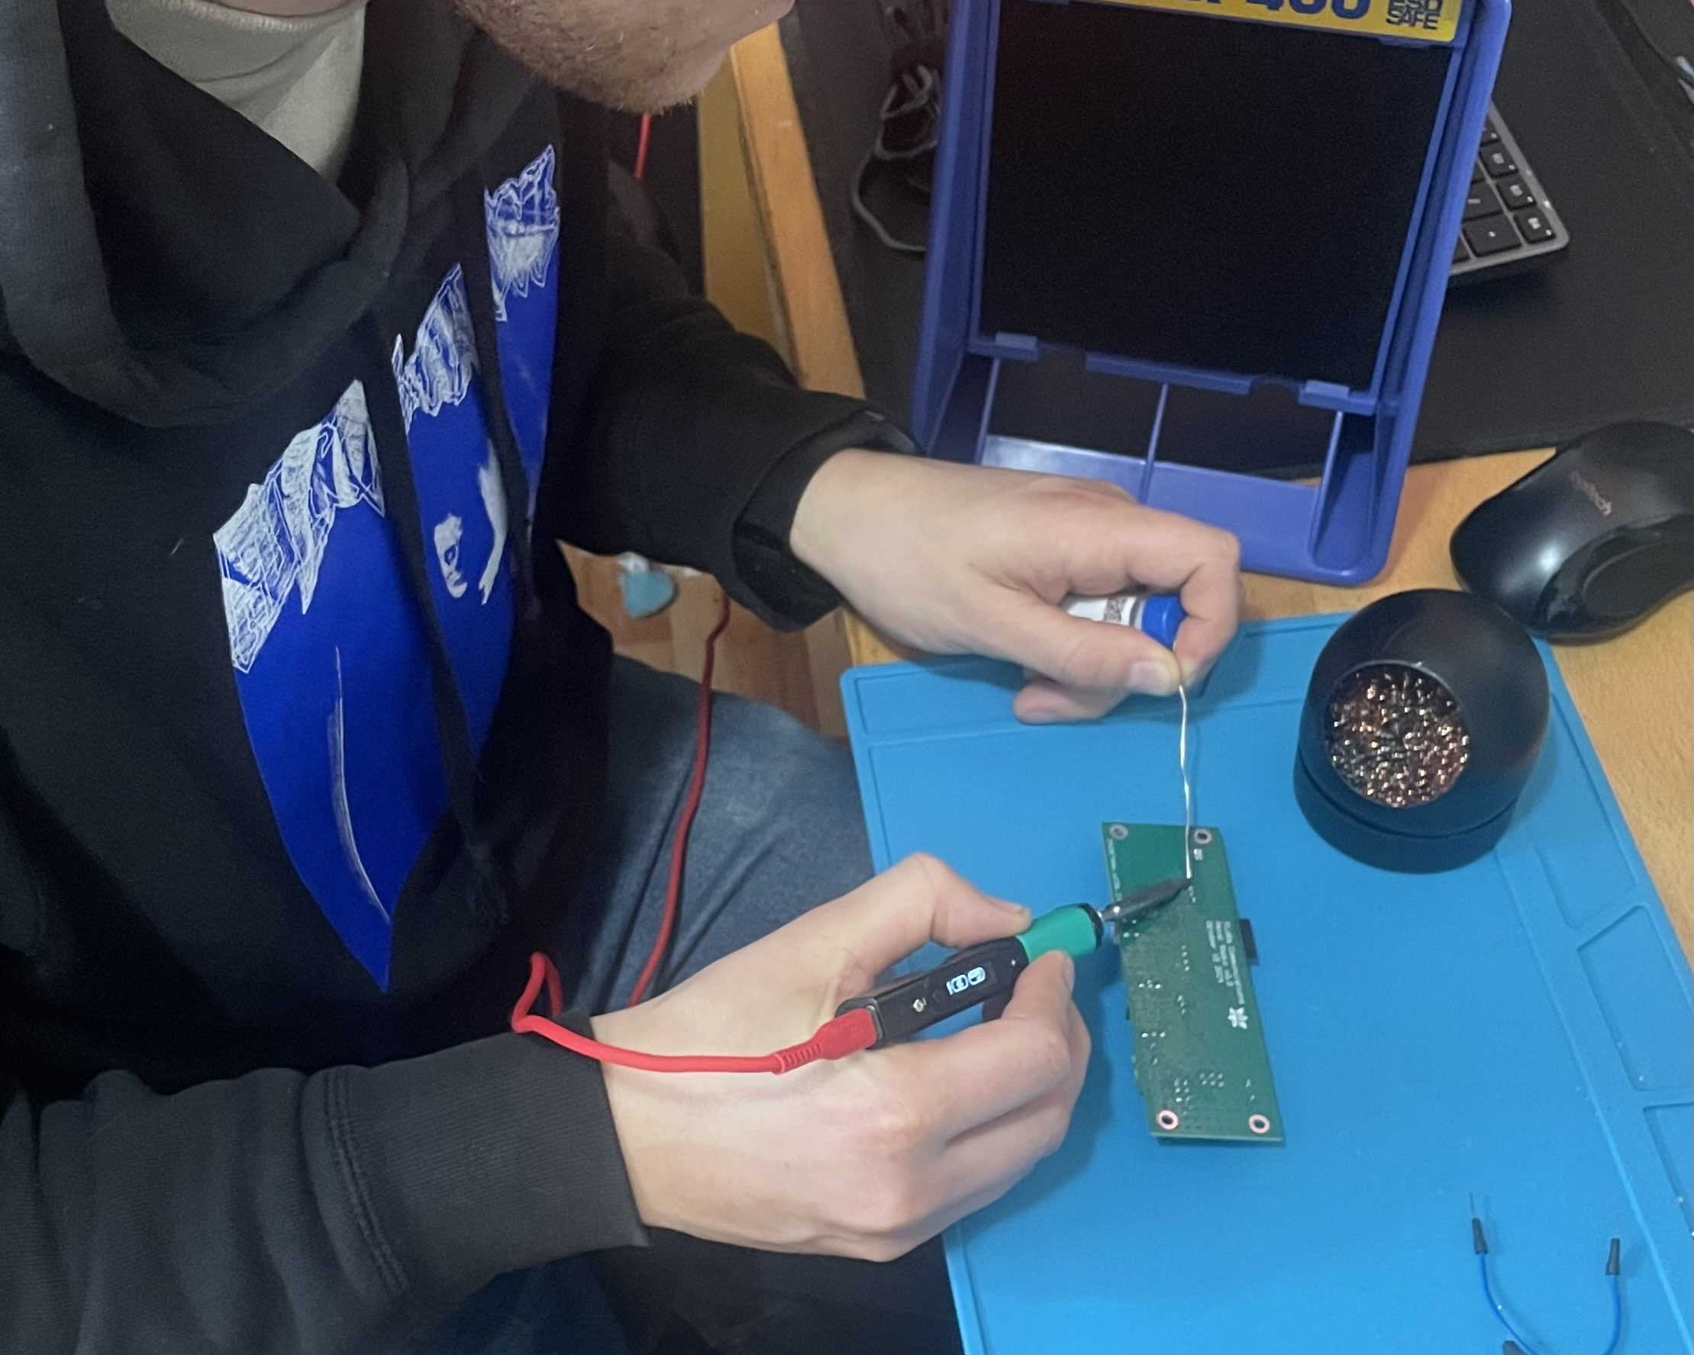
Petal Radio
Notes:
We received our PCB’s on Tuesday October 22nd and successfully assembled two complete boards on saturday October 26t^{h}.

Slide 14
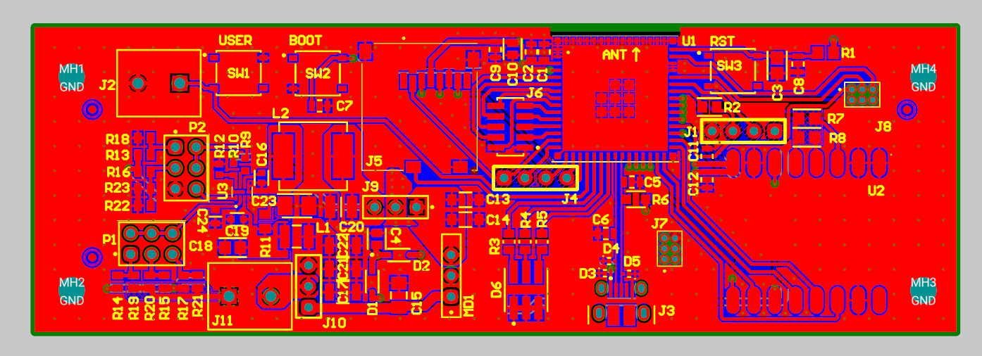
Design
The top copper printed circuit board layout in Altium
Notes:
Before diving into things too deep we wanted to prove the feasibility of our project. We set out to the Kludahk with some cheap handheld LoRa modules and to our surprise were able to transmit and receive messages upwards of a kilometer through the dense forest.
The trail was scattered with gorgeous avalanche lillies at that time of year which inspred the name of our project: FloRa Communications

Slide 15
Applying Solder paste
Notes:
Slide per pic

Slide 16
Placing components

Slide 17
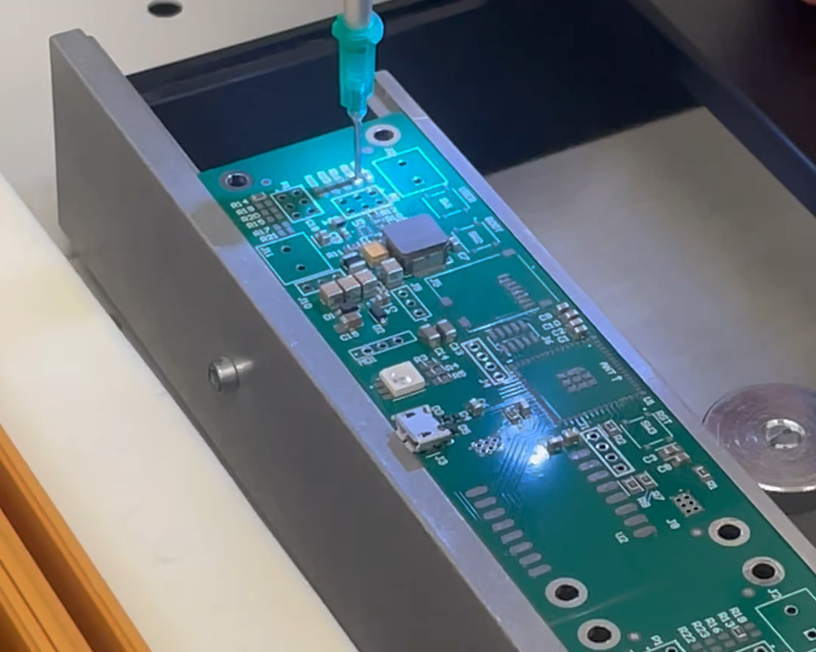
Picking and Placing

Slide 18
15 minutes in the oven

Slide 19
Soldered Through-hole components

Slide 20
One of five completed prototypes

Slide 21
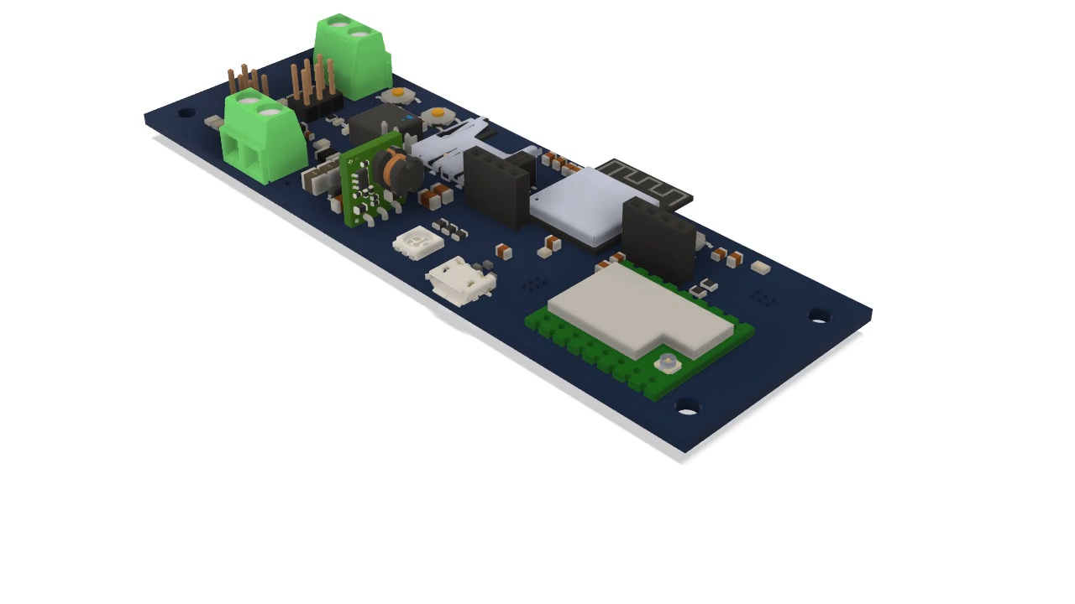
Petal Radio
SD Card
ESP32-S3 MPU
11.2 cm
Wi-Fi
Boot
Reset
Wi-Fi Breakout
UART
3.7 cm
GPIO & SPI Breakout
Battery Selection
USB
LoRa Module
RGB LED
Back Up Power Supply
Primary Power Supply
Notes:
Aaron
Board is quite large, but this is because we included a lot of redundancies in the board so we know it’s reliable.
We included two power supplies. Primary power supply is cheap, efficient, and has a low voltage disconnect, which is important for battery powered devices. We designed the low voltage disconnect to work with 6 and 12 volt lithium and 12v lead acid batteries which are selected by placing jumpers on these two pin headers. Sounds perfect, right? The catch was that we needed to design the switching circuitry around the power supply, introducing a lot of opportunity for errors in the design and building stages. A faulty power supply would render the entire batch of prototypes useless, so we also included a backup. The back up supply is a pre-fabricated module that is basically plug and play. Having both of these options means we should be able to reliably use the board to test our software.
The next part is the SD card. This holds our web app files that are much too large to fit on the microprocessor’s internal memory
And speaking of the processor, here it is. We used an esp32 s3 mini module with a built in wifi antenna.
Just like the power supplies, we wanted redundancy in our processor circuit as well. We broke out the unused gpio pins and the SPI bus to headers so we could use or test them later if needed.
We also included connections both to the chip’s usb and serial pins so we could program the chip through either method if one wasn’t working correctly.
The board also includes 3 buttons. The boot and reset button are necessary for the microprocessor, but we also included a wifi activation button that users will press to activate the wifi access point. In case the board mounted button is not accessible because of the device’s enclosure, we added a terminal block that can be wired to an external button if that is more accessible for the users.
We put the lora module in the bottom corner, as far away from the wifi antenna and the analog power circuitry, and it was given its own communication bus with the processor.
Finally, we included an RGB led that will be used to indicate the device status to the user. We’ll set it to flash different colours depending on the status of the device.
Petal v0.0 is our first prototype, and it will give us a reliable testing ground to develop software with.

Slide 22



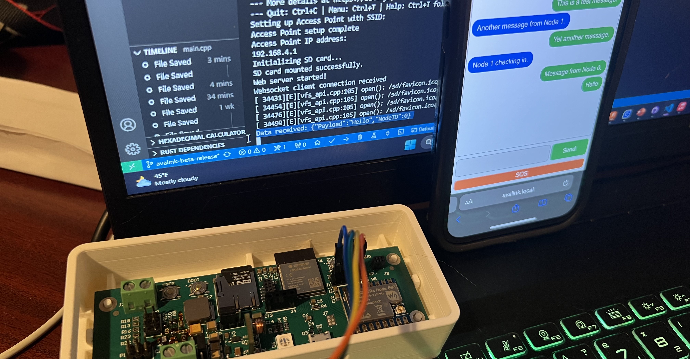
Firmware

Slide 23

Firmware Responsibilities
Serve the Web App
Interface with the LoRa Mesh Network
Manage device power usage
Notes:
3 main tasks:
1. Create a wifi access point
2. Send and Receive LoRa radio messages
3. This is designed to be an off-grid network and as such, conserving battery power and maximizing power efficiency is an essential task

Slide 24

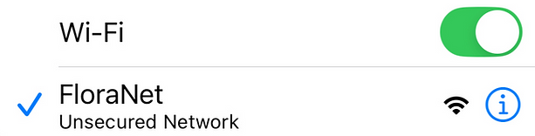
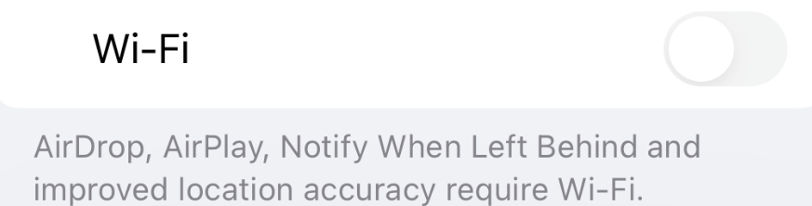


Web App Server
Pressing the user button activates the Petal
Notes:
Firmware task number 1.
Serving web app –Firmware setting up a wifi access point which wakes up on button press. They turn on their phone’s wifi and simply connect to the network.
when user wants to use a node, they press the wifi activation button – turns on wifi, user connects with phone

Slide 25

Web App Server
When activated, the ESP32-S3-MINI becomes a Wi-Fi access point that can serve the web app files
Notes:
Behind the scenes, firmware takes files from SD card and transfers them to the client’s phone. The phone then uses it’s beefy computing power to render the web app pn any browser of the user’s choosing. They need only scan a QR code brings and they arrive at the web app served by esp32 – the user can then chat.

Slide 26

LoRa Network Interface
A packet collision
Notes:
Our 2nd firmware responsibility. Interfacing with LoRa radio.
In talk radio – think walkie-talkies – the user is the collision avoidance. They check whether the channel is in use, and if it is, wait until the it’s free before they transmit. In digital radio, packets of data are transmitted at a set frequency. If more than one device is talking at the same time, the data packets will collide, corrupting the data. Our firmware therefore runs a channel activity detection protocol prior transmitting, and manages receipt and acknowledgement of messages, as well as dictates how the messages travel around the mesh network.

Slide 27
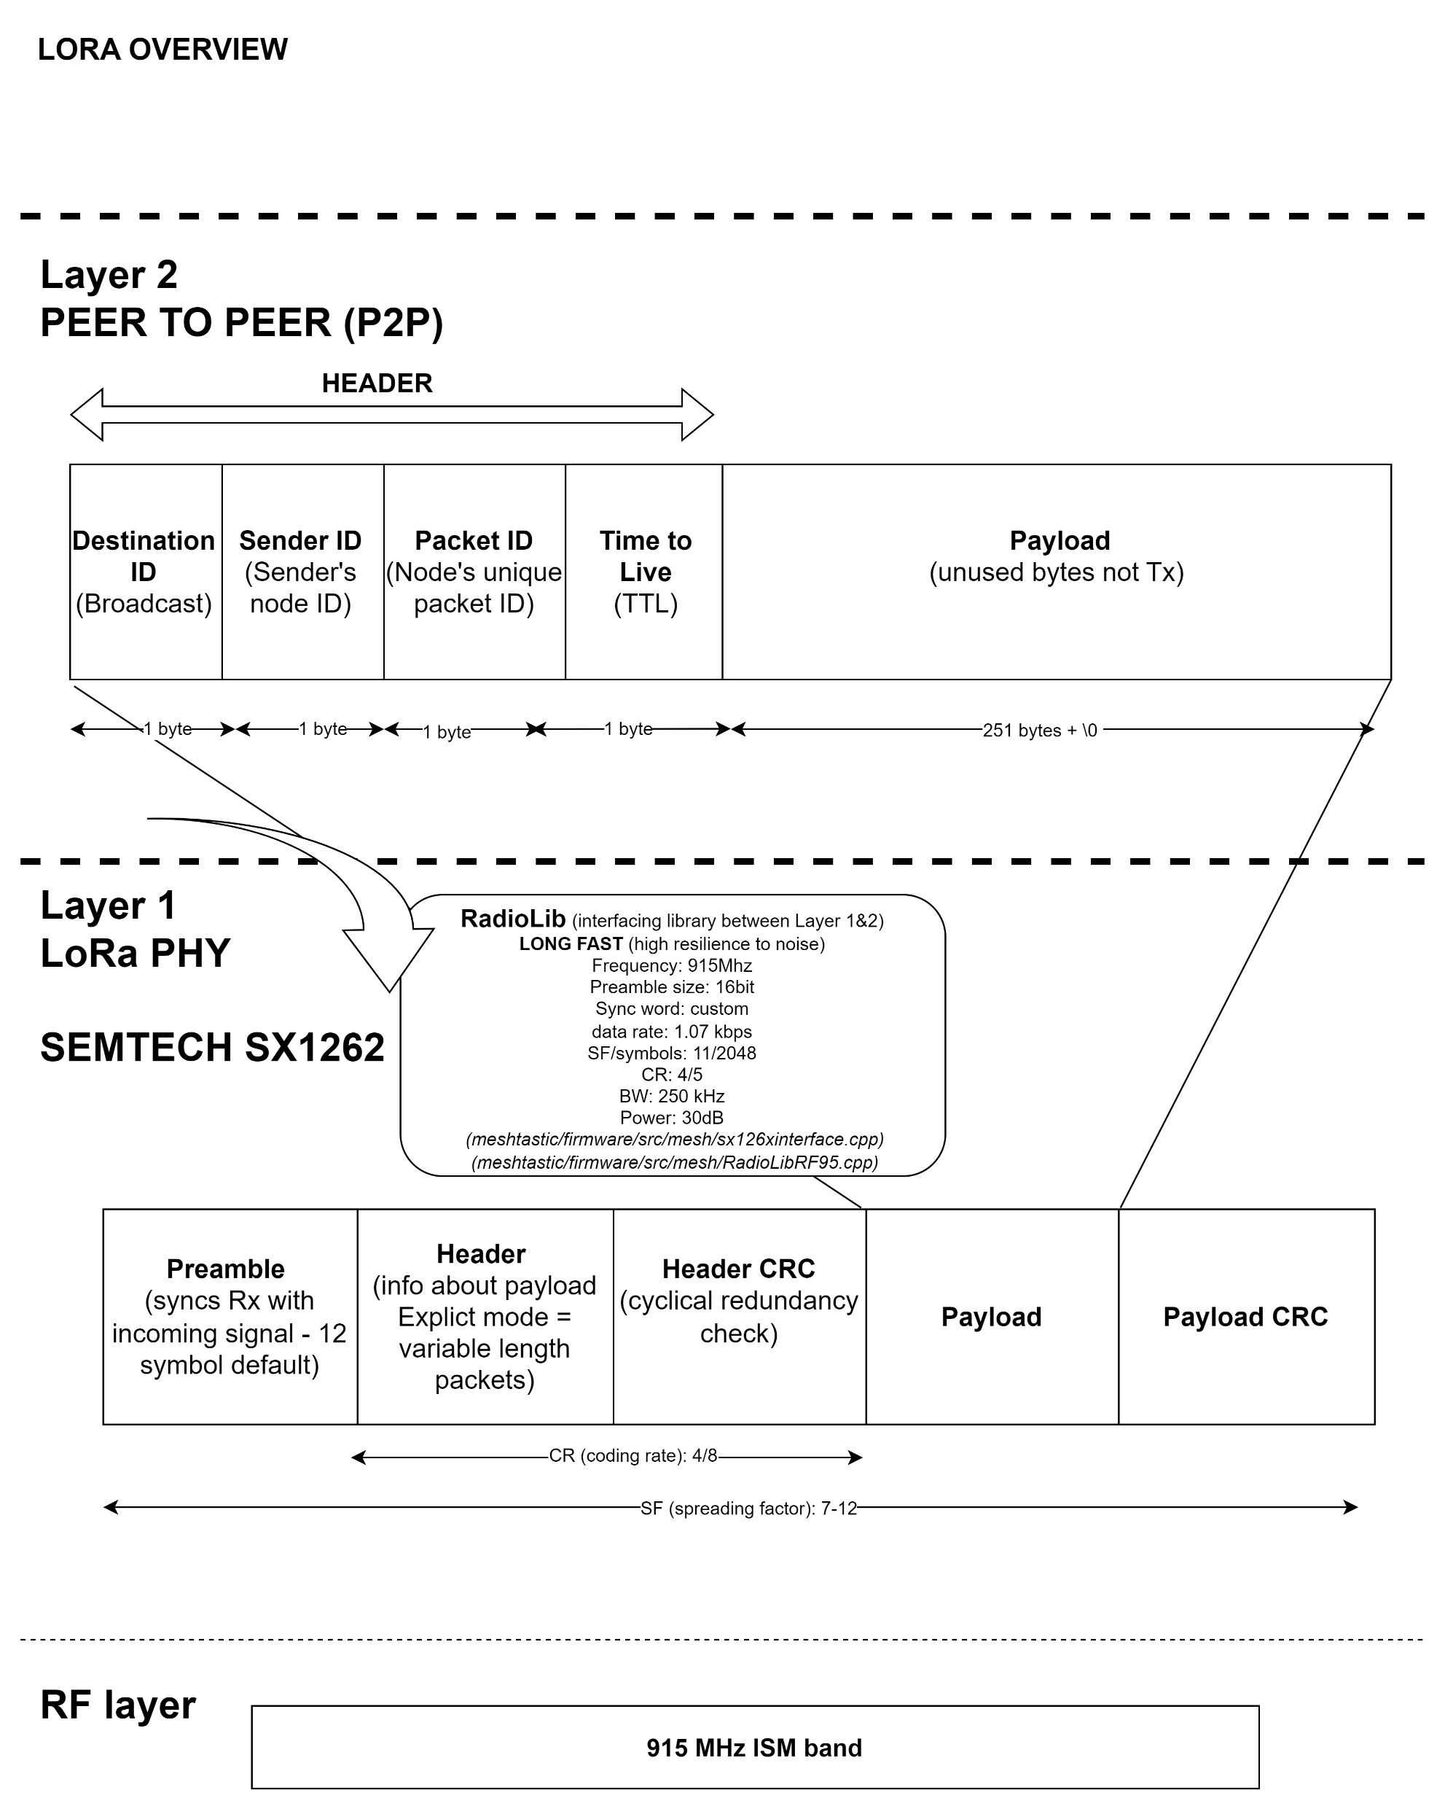
LoRa Network Interface
Our network stack
Notes:
We created our own network stack to to interface between the RF layer, the proprietary LoRa physical layer, and how we chose to handle peer to peer LoRa messaging. We won’t get to in to the weeds, on this one, but are happy to get in to the nuts and bolts of our radio protocols if anyone has questions later.

Slide 28

LoRa Network Interface
A 4-byte header solves most of our issues
Max message length is 251 characters
Notes:
Instead I’ll just focus on how our firmware deals with node to node messages in our network.
there 2 parts to a message. The “header” and the “payload”.
Let’s make a bit of a postal service analogy (when it’s not on strike)
Our firmware wraps the contents of the user’s message (the payload) in an envelope. This envelope or “header” contains all sorts of metadata as any good envelope would – what’s the address? Who’s the sender? It also assigns a unique packet ID and a time to live so the message isn’t hopping indefinitely around the mesh.
The firmware, much like Canada Post, then delivers these messages based on the information to the LoRa physical layer for transmission as well as parses all this information, when received, and delivers the message it to the user via the public chat.

Slide 29

Power Management
All power-intensive tasks have time-outs, and the processor is put to sleep to save battery
Notes:
Power efficiency is essential when running off-grid solar powered installations. Especially say in winter in the pacific northwest!
Our firmware conserves precious battery power by putting hardware to sleep when not in use, as well as waking it on the advent of a message received via LoRa, or a user activating the wifi access point to send a receive messages on the public chat.

Slide 30
Web App
Notes:
We’ve been hard at work on our web-application, and so far we have implemented the majority of the features we hope to have in our beta release

Slide 31

Web-App Development

Slide 32


Familiar Layout
Connected Node Identifier
Received messages on left of chat window
Sent messages on right of chat window
Node identifier stamp on received messages
Send button matches colour of Sent messages
Large Accessible SOS button
Notes:
Our main goal with our web-application is for users to intuitively understand how to use it, to accomplish this we’ve gone with a layout and style that resembles what is seen on most smart phones and messaging applications. TALK THROUGH ANIMATIONS.

Slide 33

Checking in on Uncle Denim
Notes:
I’m sure you’ve all been worried sick about uncle denim.

Slide 34
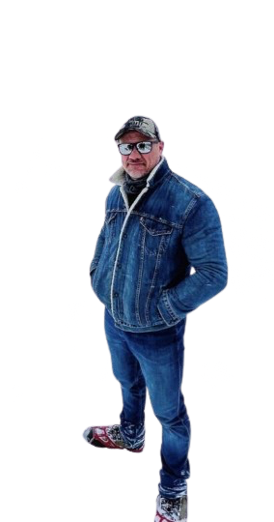


Slide 35
A special thanks to our Camosun Instructors and the Prep Room crew for all their help throughout our project.
Capstone Symposium
December 13, 2024
1000 – 1400
Camosun College Interurban
Centre for Trades Education & Innovation
Notes:
Tella

